Slide 1
Lecture Presentation
Chapter 3 Molecules, Compounds, and Chemical Equations

Slide 2
How Many Different Substances Exist?
Elements combine with each other to form compounds.
The great diversity of substances that we find in nature is a direct result of the ability of elements to form compounds.

Slide 3
Hydrogen, Oxygen, and Water
The dramatic difference between the elements hydrogen and oxygen and the compound water is typical of the differences between elements and the compounds that they form.
When two or more elements combine to form a compound, an entirely new substance results.

Slide 4
Hydrogen, Oxygen, and Water

Slide 5
Mixtures and Compounds
In a mixture, elements can mix in any proportions whatsoever (hydrogen, H₂, and oxygen, O₂).
In a compound, elements combine in fixed, definite proportions (water, H₂O).

Slide 6
Definite Proportion
A hydrogen–oxygen mixture can have any proportions of hydrogen and oxygen gas.
Water, by contrast, is composed of water molecules that always contain two hydrogen atoms to every one oxygen atom.
Water has a definite proportion of hydrogen to oxygen.

Slide 7
Definite Proportion

Slide 8
Chemical Bonds
Compounds are composed of atoms held together by chemical bonds.
Chemical bonds result from the attractions between the charged particles (the electrons and protons) that compose atoms.
Chemical bonds are broadly classified into two types:
ionic and
covalent.

Slide 9
Ionic Bonds
Ionic bonds, which occur between metals and nonmetals, involve the transfer of electrons from the metal atom to the nonmetal atom.
The metal atom then becomes a cation while the nonmetal atom becomes an anion.
These oppositely charged ions attract one another by electrostatic forces and form an ionic bond.

Slide 10
Ionic Compounds in Solid Phase
In the solid phase, the ionic compound is composed of a lattice—a regular three-dimensional array—of alternating cations and anions.

Slide 11
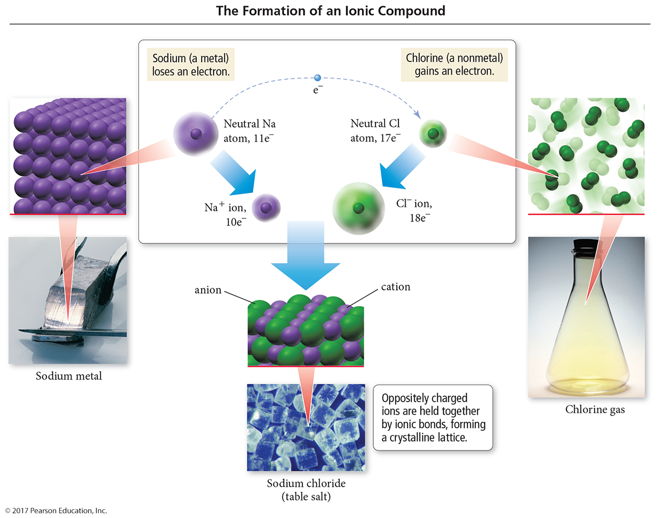
The Formation of Ionic Compounds

Slide 12
Covalent Bonds
Covalent bonds occur between two or more nonmetals. The two atoms share electrons between them, composing a molecule.
Covalently bonded compounds are also called molecular compounds.

Slide 13
Representing Compounds: Chemical Formulas and Molecular Models
A compound’s chemical formula indicates the elements present in the compound and the relative number of atoms or ions of each.
Water is represented as H₂O.
Sodium Chloride is represented as NaCl.
Carbon dioxide is represented as CO₂.
Carbon tetrachloride is represented as CCl₄.

Slide 14
Types of Chemical Formulas
Chemical formulas can generally be categorized into three different types:
empirical formulas,
molecular formulas, and
structural formulas.

Slide 15
Types of Chemical Formulas
An empirical formula gives the relative number of atoms of each element in a compound.
A molecular formula gives the actual number of atoms of each element in the molecule of a compound.
(a) For H₂O₂, the greatest common factor is 2. The empirical formula is therefore HO.
(b) For B₂H₆, the greatest common factor is 2. The empirical formula is therefore BH₃.
(c) For CCl₄, the only common factor is 1, so the empirical formula and the molecular formula are identical.

Slide 16
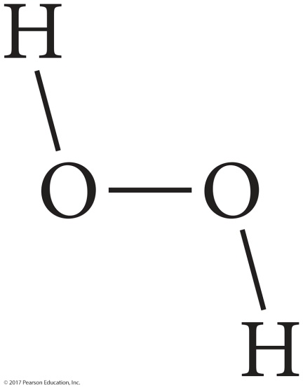
Types of Chemical Formulas
A structural formula uses lines to represent covalent bonds and shows how atoms in a molecule are connected or bonded to each other.
It can also show the molecule’s geometry.
The structural formula for H₂O₂ can be shown as either of the following.

Slide 17
Types of Chemical Formulas
The type of formula we use depends on how much we know about the compound and how much we want to communicate.
A structural formula communicates the most information. An empirical formula communicates the least.

Slide 18
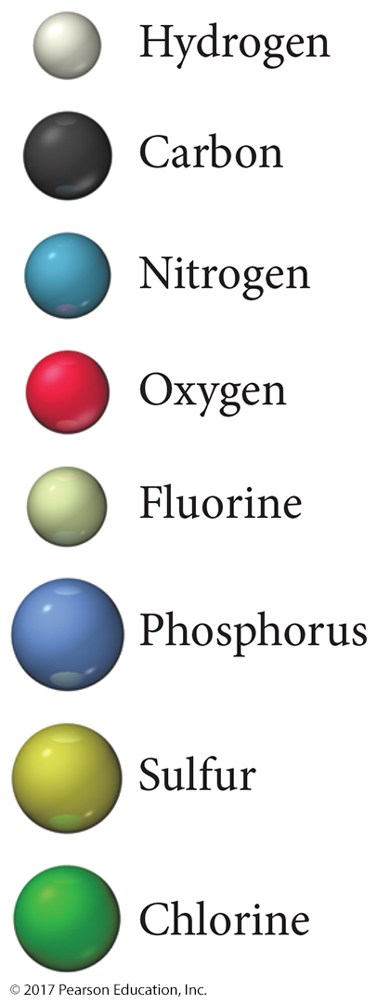
Molecular Models
A molecular model is a more accurate and complete way to specify a compound.
A ball-and-stick molecular model represents atoms as balls and chemical bonds as sticks; how the two connect reflects a molecule’s shape.
The balls are typically color-coded to specific elements.

Slide 19
Molecular Models
In a space-filling molecular model, atoms fill the space between each other to more closely represent a best estimate for how a molecule might appear if scaled to visible size.

Slide 20
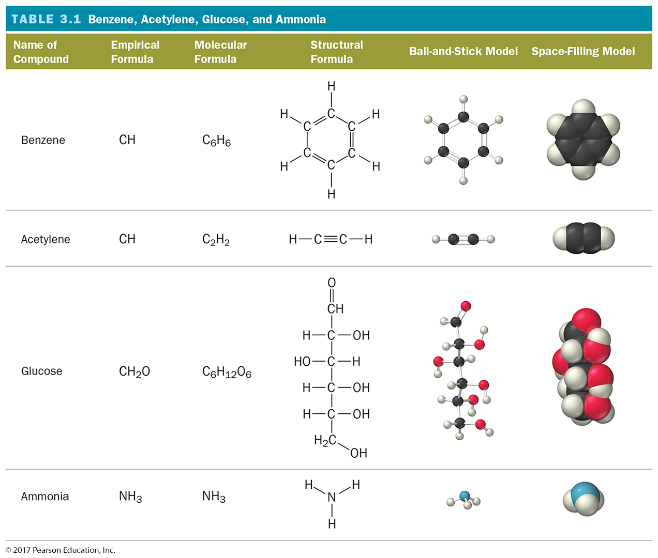
Ways of Representing a Compound

Slide 21
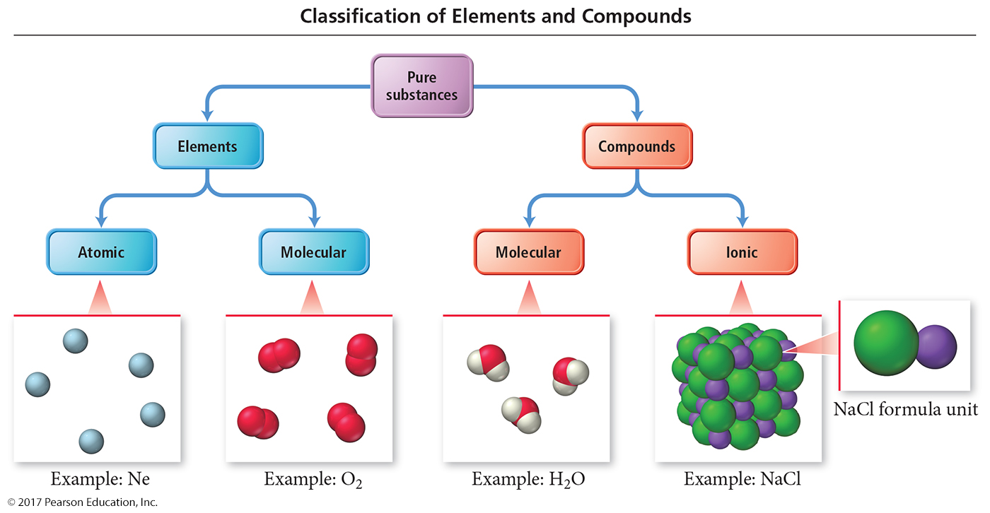
An Atomic-Level View of Elements and Compounds
Elements may be either atomic or molecular.
Compounds may be either molecular or ionic.

Slide 22
View of Elements and Compounds
Atomic elements exist in nature with single atoms as their basic units. Most elements fall into this category.
Examples are Na, Ne, K, Mg, etc.
Molecular elements do not normally exist in nature with single atoms as their basic units; instead, they exist as molecules—two or more atoms of the element bonded together.
There are only seven diatomic elements and they are H₂, N₂, O₂, F₂, Cl₂, Br₂, and I₂.
Also, P₄ and S₈ are polyatomic elements.

Slide 23
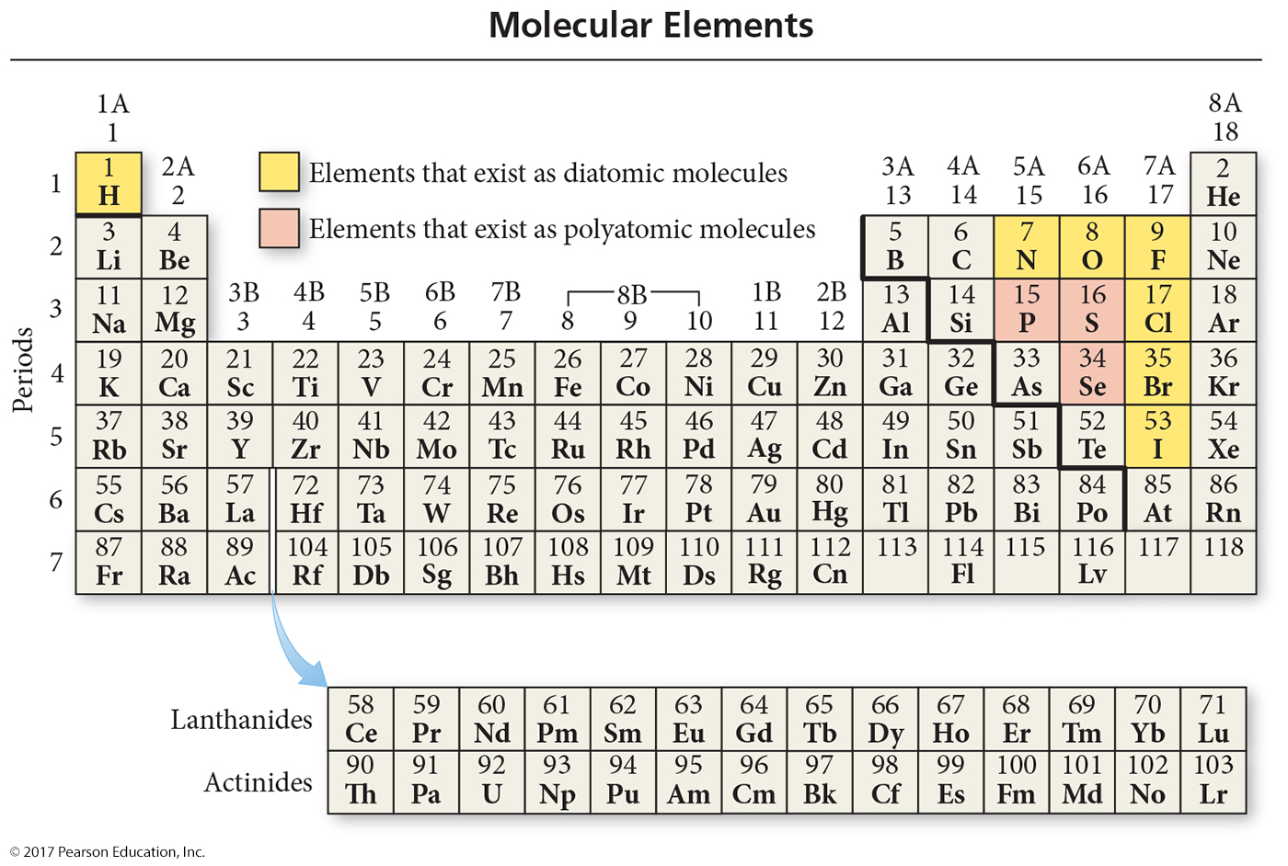
Molecular Elements

Slide 24
Molecular Compounds
Molecular compounds are usually composed of two or more covalently bonded nonmetals.
The basic units of molecular compounds are molecules composed of the constituent atoms.
Water is composed of H₂O molecules.
Dry ice is composed of CO₂ molecules.
Propane (often used as a fuel for grills) is composed of C₃H₈ molecules.

Slide 25
Ionic Compounds
Ionic compounds are composed of cations (usually a metal) and anions (usually one or more nonmetals) bound together by ionic bonds.
The basic unit of an ionic compound is the formula unit, the smallest, electrically neutral collection of ions.
Table salt is an ionic compound with the formula unit NaCl, which is composed of Na⁺ and Cl– ions in a one-to-one ratio.

Slide 26
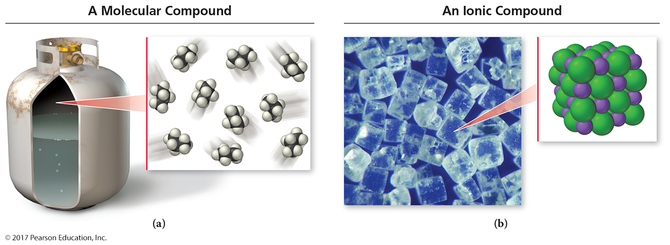
Molecular and Ionic Compounds

Slide 27
Polyatomic Ions
Many common ionic compounds contain ions that are themselves composed of a group of covalently bonded atoms with an overall charge.
This group of charged species is called polyatomic ions.
NaNO₃ contains Na⁺ and NO₃–.
CaCO₃ contains Ca²⁺ and CO₃^{2–}.
Mg(ClO₃)₂ contains Mg²⁺ and ClO₃–.

Slide 28
Ionic Compounds: Formulas and Names
Summarizing Ionic Compound Formulas
Ionic compounds always contain positive and negative ions.
In a chemical formula, the sum of the charges of the cations must equal the sum of the charges of the anions.
The formula of an ionic compound reflects the smallest whole-number ratio of ions.

Slide 29
Ionic Compounds: Formulas and Names
The charges of the representative elements can be predicted from their group numbers.
The representative elements form only one type of charge.
Transition metals tend to form multiple types of charges.
Hence, their charges cannot be predicted as in the case of most representative elements.

Slide 30
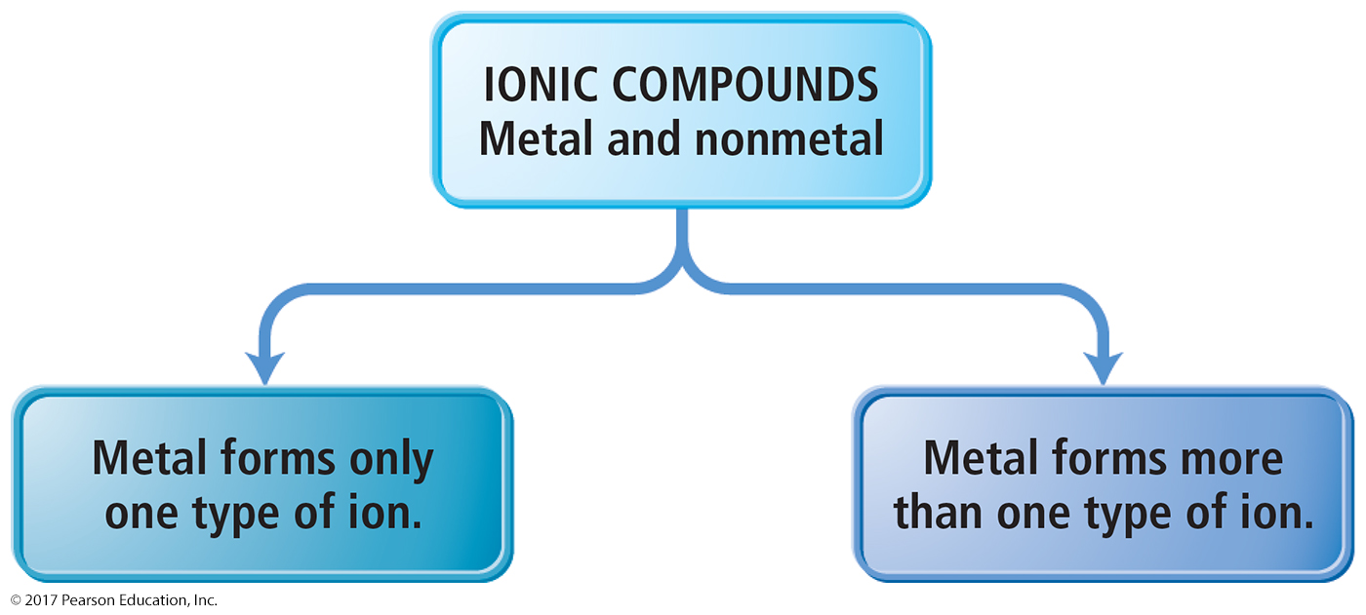
Naming Ionic Compounds
Ionic compounds can be categorized into two types, depending on the metal in the compound.
Type I
Type II

Slide 31
Naming Type I Ionic Compounds
Type I ionic compounds contain a metal whose charge is invariant from one compound to another when bonded with a nonmetal anion.
The metal ion always has the same charge.

Slide 32
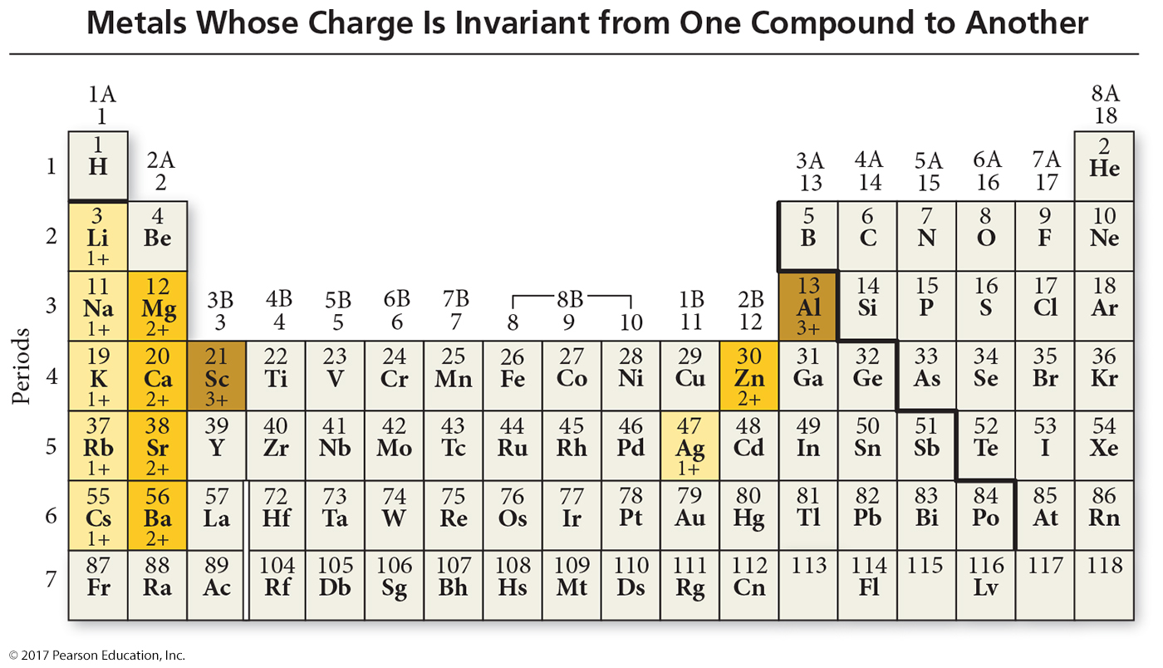
Metals Whose Charge Are Invariant from One Compound to Another

Slide 33
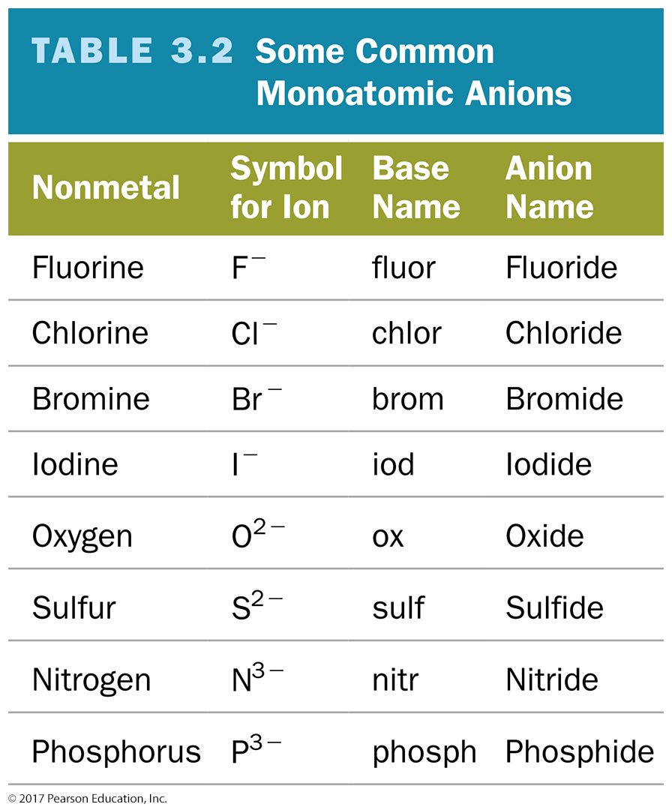

Slide 34
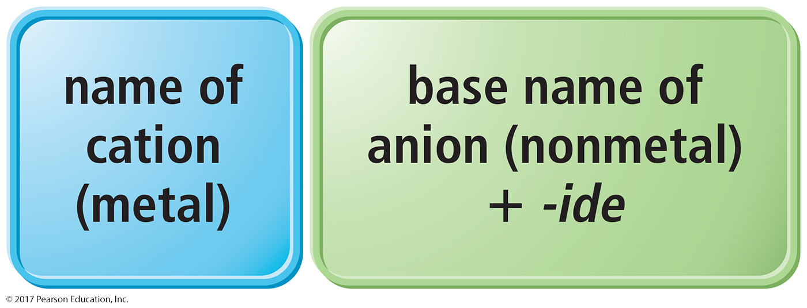
Naming Binary Ionic Compounds of Type I Cations
Binary compounds contain only two different elements. The names of binary ionic compounds take the following form:

Slide 35
Examples: Type I Binary Ionic Compounds
The name for KCl consists of the name of the cation, potassium, followed by the base name of the anion, chlor, with the ending -ide.
KCl is potassium chloride.
The name for CaO consists of the name of the cation, calcium, followed by the base name of the anion, ox, with the ending -ide.
CaO is calcium oxide.

Slide 36
Naming Type II Ionic Compounds
The second type of ionic compound contains a metal that can form more than one kind of cation, depending on the compound, bonded to a nonmetal anion.
The metal’s charge must be specified for a given compound.
The proportion of metal cation to nonmetal anion helps us determine the charge on the metal ion.

Slide 37
Type II Ionic Compounds
Iron, for instance, forms a 2+ cation in some of its compounds and a 3+ cation in others.
Metals of this type are often transition metals.
FeS: Here, iron is +2 cation (Fe²⁺).
Fe₂S₃: Here, iron is +3 cation (Fe³⁺).
Cu₂O: Here, copper is +1 cation (Cu⁺).
CuO: Here, copper is +2 cation (Cu²⁺).
Some main group metals, such as Pb, Ti, and Sn, form more than one type of cation.

Slide 38
Naming Type II Binary Ionic Compounds
The full name of compounds containing metals that form more than one kind of cation have the following form:
The charge of the metal cation can be determined by inference from the sum of the charges of the nonmetal.

Slide 39
Naming Type II Binary Ionic Compounds
For these types of metals, the name of the cation is followed by a roman numeral (in parentheses) that indicates the charge of the metal in that particular compound.
For example, we distinguish between Fe²⁺ and Fe³⁺ as follows:
Fe²⁺ Iron(II)
Fe³⁺ Iron(III)

Slide 40
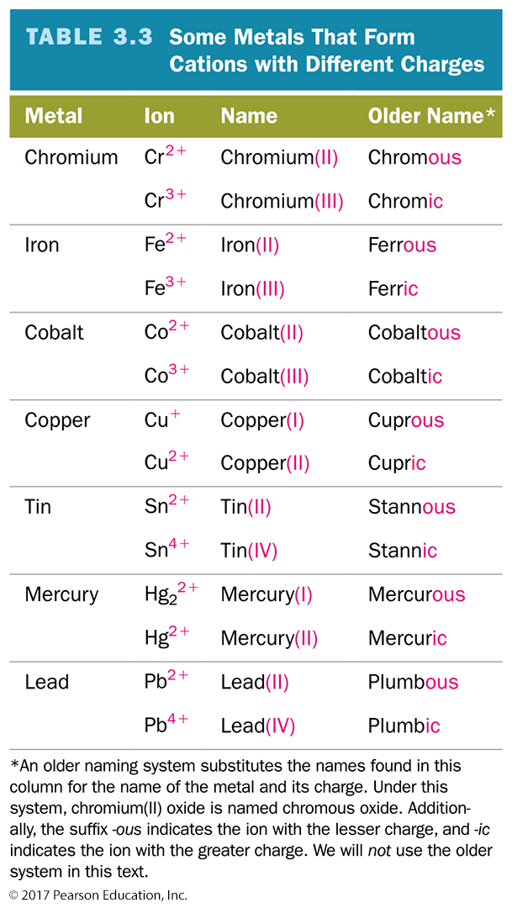

Slide 41
Example: Type II Binary Ionic Compounds
To name CrBr₃,determine the charge on the chromium.
Total charge on cation + total anion charge = 0.
Cr charge + 3(Br– charge) = 0.
Since each Br has a –1 charge, then:
Cr charge + 3(–1) = 0.
Cr charge –3 = 0.
Cr = +3.
Hence, the cation Cr³⁺ is called chromium(III), while Br– is called bromide.
Therefore, CrBr₃ is chromium(III) bromide.

Slide 42
Naming Ionic Compounds Containing Polyatomic Ions
We name ionic compounds that contain a polyatomic ion in the same way as other ionic compounds, except that we use the name of the polyatomic ion whenever it occurs.
For example, NaNO₂ is named according to its cation, Na⁺, sodium, and its polyatomic anion, NO₂–, nitrite.
Hence, NaNO₂ is sodium nitrite.

Slide 43
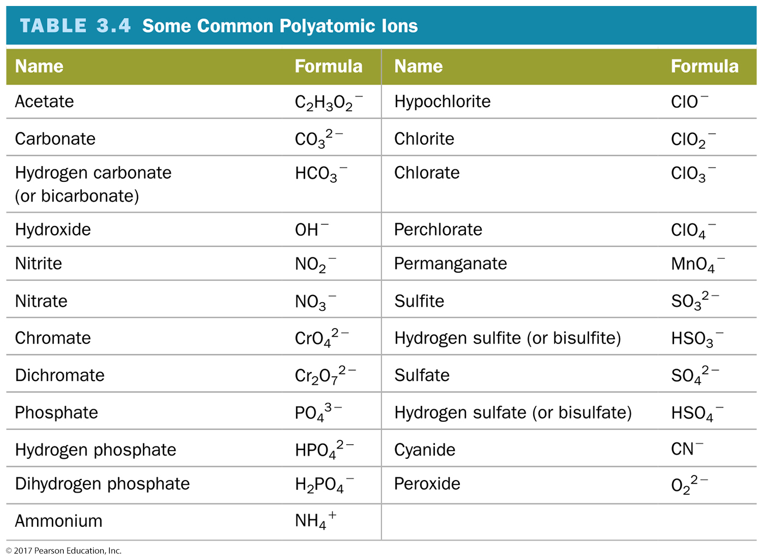

Slide 44
Oxyanions
Most polyatomic ions are oxyanions, anions containing oxygen and another element.
Notice that when a series of oxyanions contains different numbers of oxygen atoms, they are named according to the number of oxygen atoms in the ion.
If there are two ions in the series,
the one with more oxygen atoms has the ending -ate, and
the one with fewer has the ending -ite.
For example,
NO₃– is nitrate.
SO₄^{2–} is sulfate.
NO₂– is nitrite.
SO₃^{2–} is sulfite.

Slide 45
Oxyanions
If there are more than two ions in the series, then the prefixes hypo-, meaning less than, and per-, meaning more than, are used.
ClO– hypochlorite BrO– hypobromite
ClO₂– chlorite BrO₂– bromite
ClO₃– chlorate BrO₃– bromate
ClO₄– perchlorate BrO₄– perbromate

Slide 46
Hydrated Ionic Compounds
Hydrates are ionic compounds containing a specific number of water molecules associated with each formula unit.
For example, the formula for epsom salts is MgSO₄ • 7H₂O.
Its systematic name is magnesium sulfate heptahydrate.
CoCl₂ • 6H₂O is cobalt(II) chloride hexahydrate.

Slide 47
Common Hydrate Prefixes
Common hydrate prefixes
hemi = ½ tri = 3 hexa = 6
mono = 1 tetra = 4 hepta = 7
di = 2 penta = 5 octa = 8
Other common hydrated ionic compounds and their names are as follows:
CaSO₄ • ½ H₂O is called calcium sulfate hemihydrate.
BaCl₂ • 6H₂O is called barium chloride hexahydrate.
CuSO₄ • 6H₂O is called copper sulfate hexahydrate.

Slide 48
Molecular Compounds: Formulas and Names
The formula for a molecular compound cannot readily be determined from its constituent elements because the same combination of elements may form many different molecular compounds, each with a different formula.
Nitrogen and oxygen form all of the following unique molecular compounds: NO, NO₂, N₂O, N₂O₃, N₂O₄, and N₂O₅.

Slide 49
Molecular Compounds: Formulas and Names
Molecular compounds are composed of two or more nonmetals.
Generally, write the name of the element with the smallest group number first.
If the two elements lie in the same group, then write the element with the greatest row number first.
The prefixes given to each element indicate the number of atoms present.

Slide 50
Binary Molecular Compounds
These prefixes are the same as those used in naming hydrates:
mono = 1 hexa = 6 di = 2 hepta = 7 tri = 3 octa = 8 tetra = 4 nona = 9 penta = 5 deca = 10
If there is only one atom of the first element in the formula, the prefix mono- is normally omitted.

Slide 51
Acids
Acids are molecular compounds that release hydrogen ions (H⁺) when dissolved in water.
Acids are composed of hydrogen, usually written first in their formulas, and one or more nonmetals, written second.

Slide 52
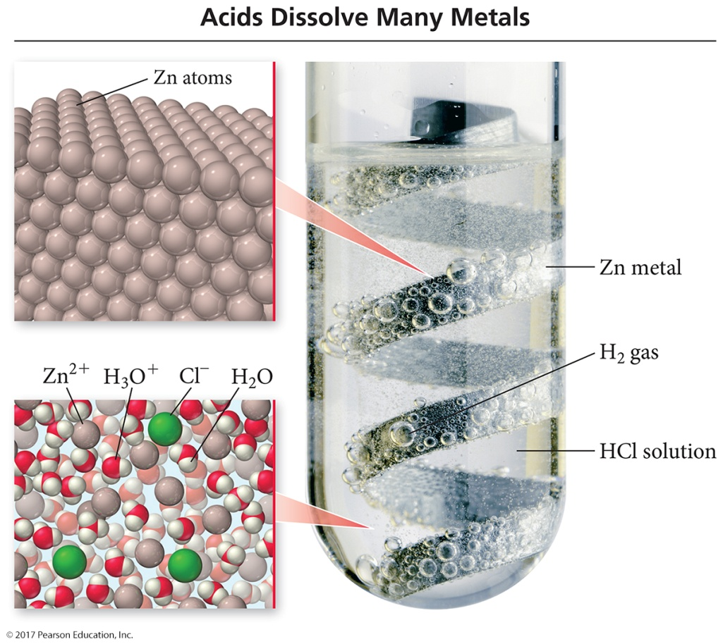
Acids
Sour taste
Dissolve many metals
such as Zn, Fe, and Mg; but not Au, Ag, or Pt
Formulas generally start with H,
e.g., HCl, H₂SO₄
HCI is a molecular compound that, when dissolved in water, forms H⁺_{(aq)} and Cl–_{(aq)} ions, where aqueous (aq) means dissolved in water.

Slide 53
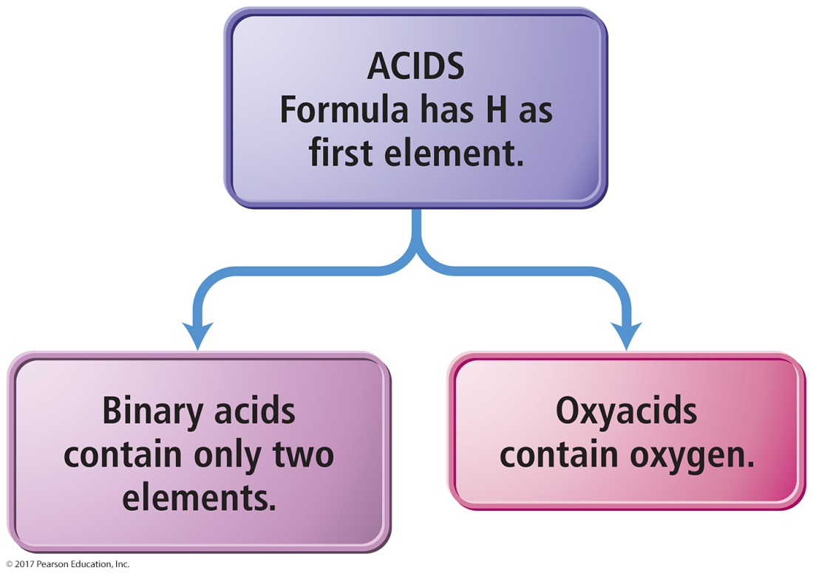
Acids
Binary acids have H⁺ cation and nonmetal anion.
Oxyacids have H⁺ cation and polyatomic anion.

Slide 54
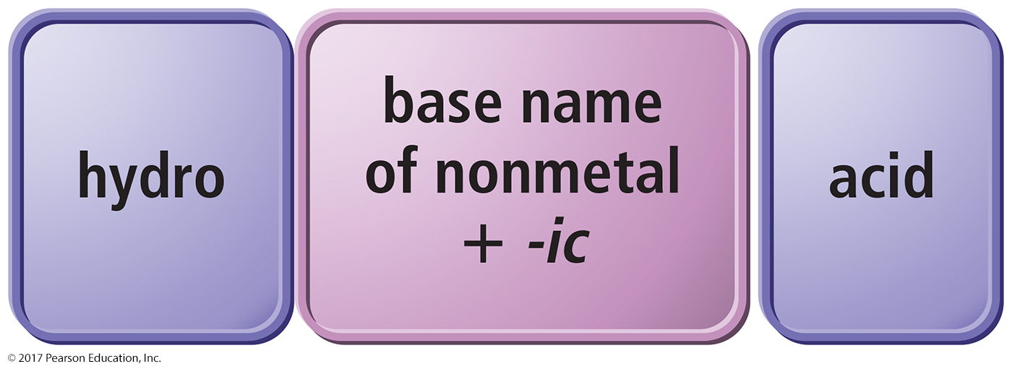
Naming Binary Acids
Write a hydro- prefix.
Follow with the nonmetal base name.
Add –ic.
Write the word acid at the end of the name.

Slide 55
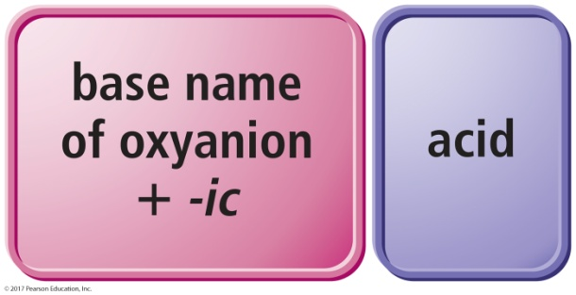
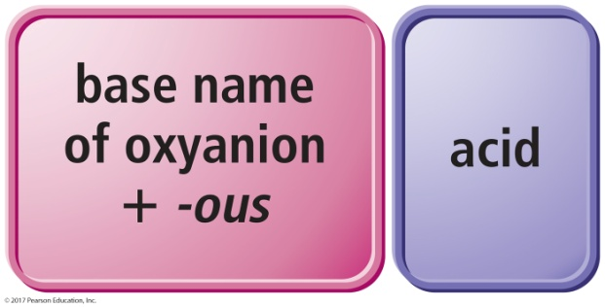
Naming Oxyacids
If the polyatomic ion name ends in –ate, change ending to –ic.
If the polyatomic ion name ends in –ite, change ending to –ous.
Write word acid at the end of all names.
oxyanions ending with -ate
oxyanions ending with -ite

Slide 56
Practice: Name the Acid
1. H₂S
2. HClO₃
3. HC₂H₃O₂

Slide 57
Practice: Name the Acid
1. H₂S hydrosulfuric acid
2. HClO₃ chloric acid
3. HC₂H₃O₂ acetic acid

Slide 58
Writing Formulas for Acids
When the name ends in acid, the formula starts with H followed by an anion.
Write the formula as if it is ionic, even though it is molecular.
Hydro- prefix means it is binary acid; no prefix means it is an oxyacid.
For an oxyacid,
if the ending is –ic, the polyatomic ion ends in –ate.
if the ending is –ous, the polyatomic ion ends in –ous.

Slide 59
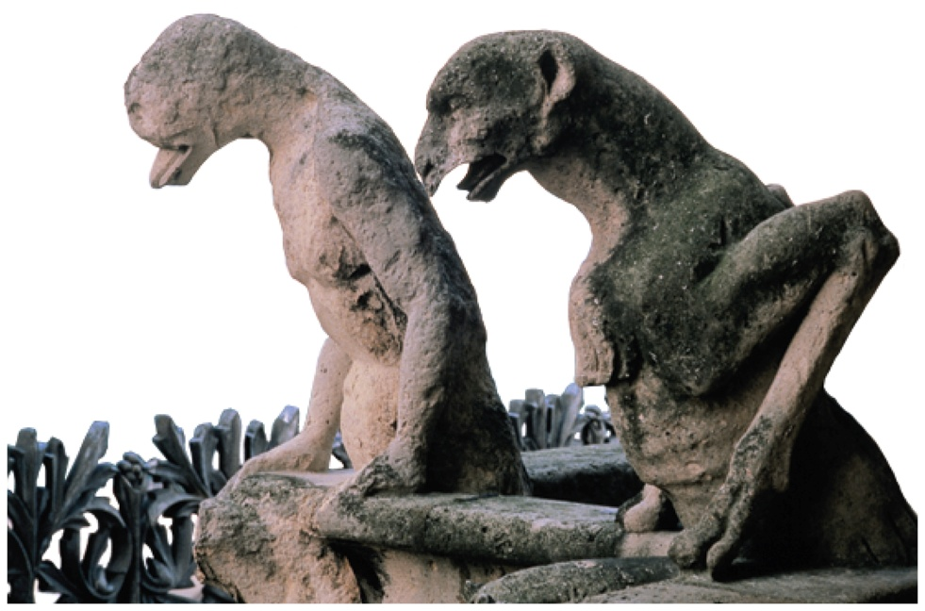
Acid Rain
Certain pollutants, such as NO, NO₂, SO₂, and SO₃, form acids when mixed with water, resulting in acidic rainwater.
Acid rain can fall or flow into lakes and streams, making these bodies of water more acidic.

Slide 60
Inorganic Nomenclature Flow Chart

Slide 61
Formula Mass
The mass of an individual molecule or formula unit
also known as molecular mass or molecular weight
Sum of the masses of the atoms in a single molecule or formula unit
whole = sum of the parts!
Mass of 1 molecule of H₂O =
(2 atoms H)(1.01 amu/H atom) + (1 atom O)(16.00 amu/atom O) = 18.02 amu

Slide 62
Molar Mass of Compounds
The molar mass of a compound—the mass, in grams, of 1 mol of its molecules or formula units—is numerically equivalent to its formula mass with units of g/mol.

Slide 63
Molar Mass of Compounds
The relative masses of molecules can be calculated from atomic masses:
formula mass = 1 molecule of H₂O = 2(1.01 amu H) + 16.00 amu O = 18.02 amu
1 mole of H₂O contains 2 moles of H and 1 mole of O:
molar mass = 1 mole H₂O
= 2mol(1.01 g/1 mol H) + 1mol(16.00 g/1 mol O) = 18.02 g/1 mol H₂O
So the molar mass of H₂O is 18.02 g/mole.
Molar mass = formula mass (in g/mole)

Slide 64
Using Molar Mass to Count Molecules by Weighing
Molar mass in combination with Avogadro’s number can be used to determine the number of atoms in a given mass of the element.
Use molar mass to convert to the amount in moles. Then use Avogadro’s number to convert to number of molecules.

Slide 65
Composition of Compounds
A chemical formula, in combination with the molar masses of its constituent elements, indicates the relative quantities of each element in a compound.

Slide 66
Composition of Compounds
Percentage by mass of each element in a compound. Can be determined from
the formula of the compound and
the experimental mass analysis of the compound.
The percentages may not always total to 100% due to rounding.

Slide 67
Conversion Factors from Chemical Formulas
Chemical formulas show the relationship between numbers of atoms and molecules.
Or moles of atoms and molecules
58.64 g Cl : 100 g CCl₂F₂
1 mol CCl₂F₂ : 2 mol Cl
These relationships can be used to determine the amounts of constituent elements and molecules.
Like percent composition

Slide 68
Determining a Chemical Formula from Experimental Data
Empirical Formula
Simplest, whole-number ratio of the atoms or moles of elements in a compound, not a ratio of masses
Can be determined from elemental analysis
Percent composition
Masses of elements formed when a compound is decomposed, or that react together to form a compound

Slide 69
Finding an Empirical Formula
1. Convert the percentages to grams.
(a) Assume you start with 100 g of the compound.
(b) Skip if it is already in grams.
2. Convert grams to moles.
(a) Use the molar mass of each element.
3. Write a pseudoformula using moles as subscripts.

Slide 70
Finding an Empirical Formula (continued)
4. Divide all by the smallest number of moles.
(a) If the result is within 0.1 of a whole number, round to the whole number.
5. Multiply all mole ratios by a number to make all whole numbers.
(a) If ratio is .5, multiply all by 2.
(b) If ratio is .33 or .67, multiply all by 3.
(c) If ratio is 0.25 or 0.75, multiply all by 4, etc.
(d) Skip if ratios are already whole numbers.

Slide 71
Molecular Formulas for Compounds
The molecular formula is a whole-number multiple of the empirical formula.
To determine the molecular formula, you need to know the empirical formula and the molar mass of the compound.
Molecular formula = (empirical formula)n,
where n is a positive integer.

Slide 72
Combustion Analysis
A common technique for analyzing compounds is to burn a known mass of compound and weigh the amounts of products.
This is generally used for organic compounds containing C, H, and O.
By knowing the mass of the products and composition of constituent element in the product, the original amount of constituent element can be determined.
All the original C forms CO₂, the original H forms H₂O, and the original mass of O is found by subtraction.
Once the masses of all the constituent elements in the original compound have been determined, the empirical formula can be found.

Slide 73
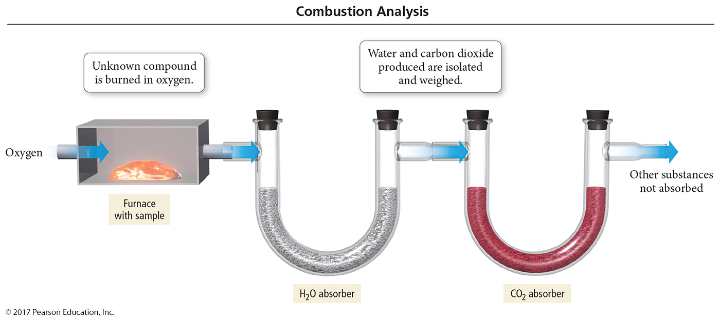
Combustion Analysis

Slide 74
Chemical Reactions
Reactions involve chemical changes in matter resulting in new substances.
Reactions involve rearrangement and exchange of atoms to produce new molecules.
Elements are not transmuted during a reaction.
Reactants Products

Slide 75
Chemical Equations
Shorthand way of describing a reaction
Provide information about the reaction
Formulas of reactants and products
States of reactants and products
Relative numbers of reactant and product molecules that are required can be used to determine weights of reactants used and products that can be made

Slide 77
Combustion of Methane
Methane gas burns to produce carbon dioxide gas and gaseous water.
Whenever something burns it combines with O₂(g).
CH₄(g) + O₂(g) → CO₂(g) + H₂O(g)
If you look closely, you should immediately spot a problem.

Slide 78
Combustion of Methane
Notice also that the left side has four hydrogen atoms while the right side has only two.
To correct these problems, we must balance the equation by changing the coefficients, not the subscripts.

Slide 79
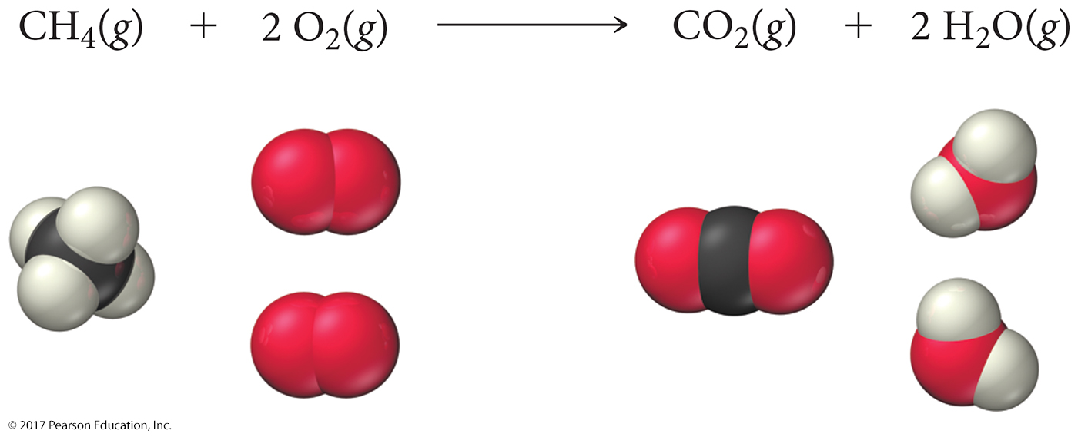
Combustion of Methane: Balanced
To show that the reaction obeys the Law of Conservation of Mass, the equation must be balanced.
We adjust the numbers of molecules so there are equal numbers of atoms of each element on both sides of the arrow.

Slide 80
Organic Compounds
Early chemists divided compounds into two types: organic and inorganic.
Compounds originating from living things were called organic; compounds originating from the earth were called inorganic.
Organic compounds were easily decomposed and could not be made in the lab.
Inorganic compounds were very difficult to decompose but could be synthesized.

Slide 81
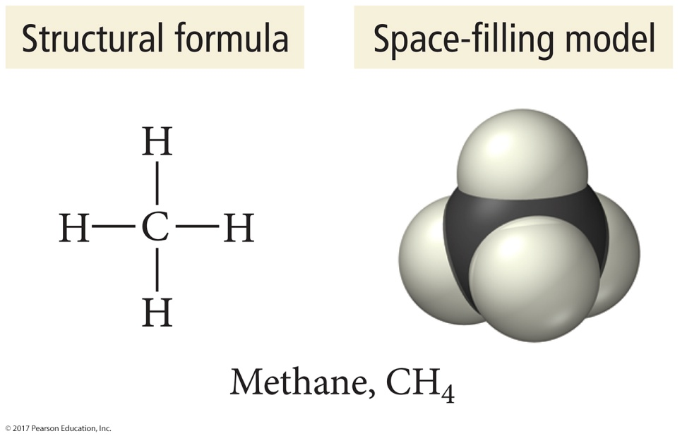
Modern Organic Compounds
Today, organic compounds are commonly made in the lab and we find them all around us.
Organic compounds are mainly made of C and H, sometimes with O, N, P, S, and trace amounts of other elements.
The key element of organic chemistry is carbon.

Slide 82
Carbon Bonding
Carbon atoms bond almost exclusively covalently.
Compounds with ionic bonding C are generally inorganic.
When C bonds, it forms four covalent bonds, including single, double, and triple bonds.
Carbon is unique in that it can bond with itself and form limitless chains of C atoms, both straight and branched, as well as rings of C atoms.

Slide 83
Carbon Bonding

Slide 84
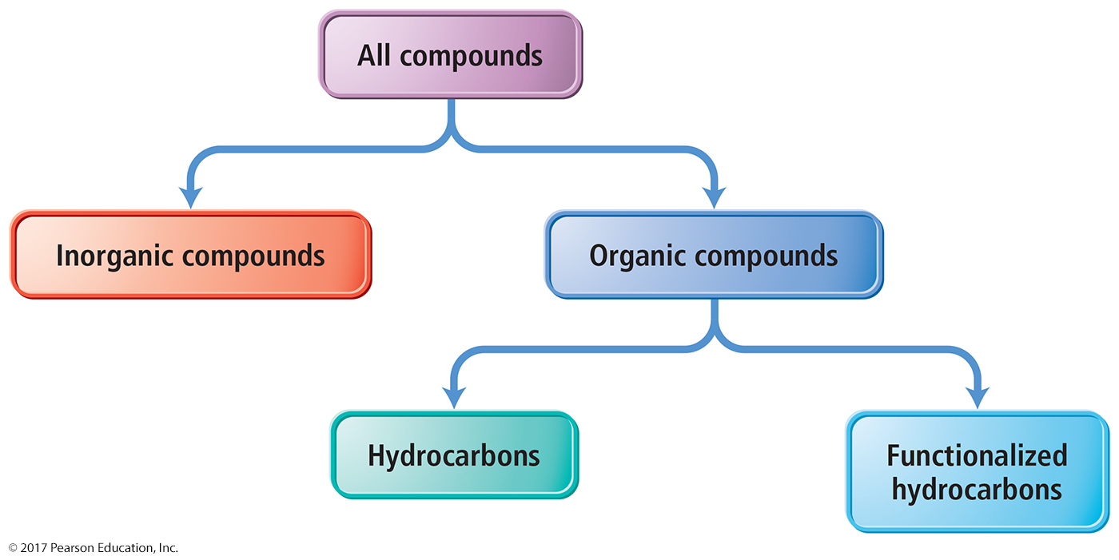
Hydrocarbons
Organic compounds can be categorized into two types: hydrocarbons and functionalized hydrocarbons.

Slide 85
Hydrocarbons
Hydrocarbons are organic compounds that contain only carbon and hydrogen.
Hydrocarbons compose common fuels such as
oil,
gasoline,
liquid propane gas,
and natural gas.

Slide 86
Naming of Hydrocarbons
Hydrocarbons containing only single bonds are called alkanes.
Those containing double or triple bonds are alkenes and alkynes, respectively.
Hydrocarbons consist of a base name and a suffix.
alkane (-ane)
alkene (-ene)
alkyne (-yne)
The base names for a number of hydrocarbons are listed here:
1 meth- 6 hex-
2 eth- 7 hept-
3 prop- 8 oct-
4 but- 9 non-
5 pent- 10 dec-

Slide 87
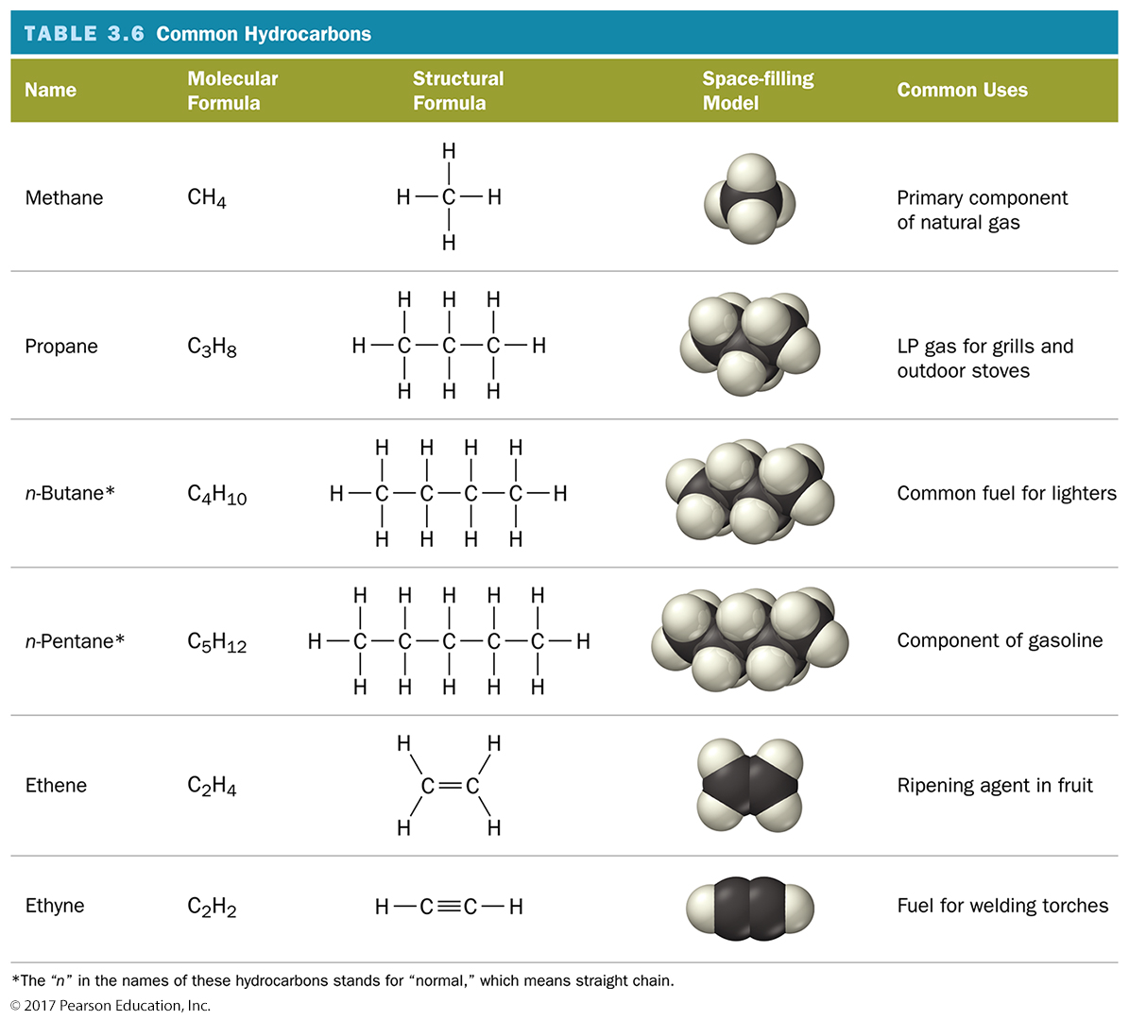

Slide 88
Functionalized Hydrocarbons
The term functional group derives from the functionality or chemical character that a specific atom or group of atoms imparts to an organic compound.
Even a carbon–carbon double or triple bond can justifiably be called a “functional group.”
A group of organic compounds with the same functional group forms a family.

Slide 89
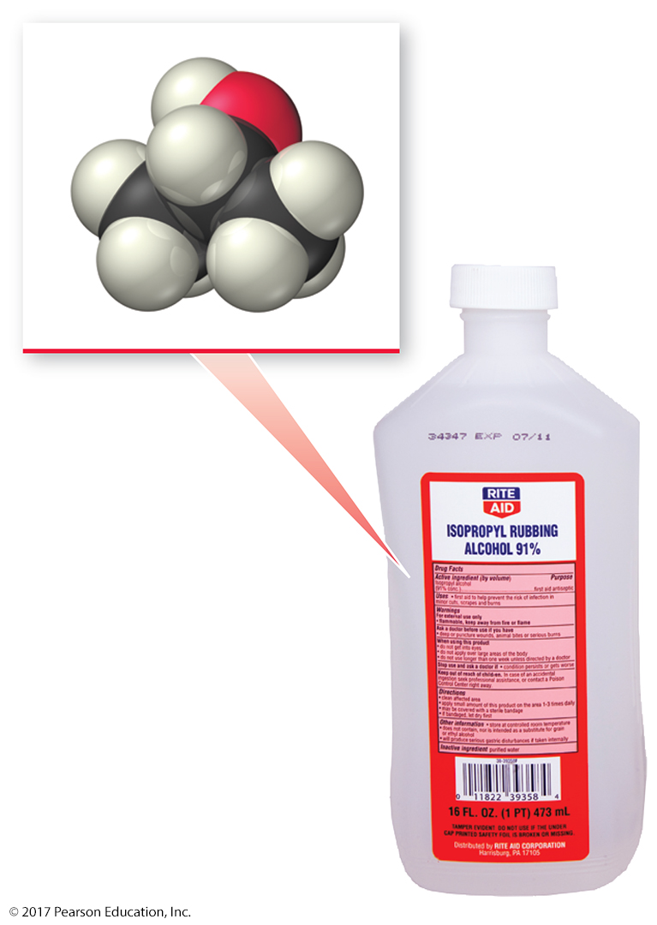
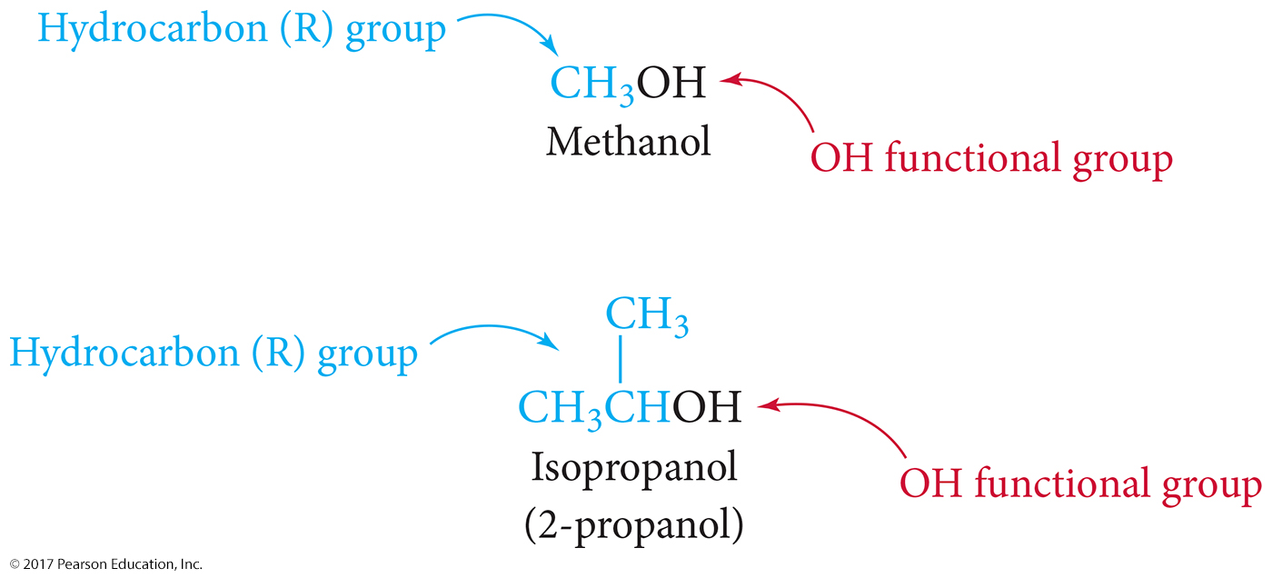
Functionalized Hydrocarbons

Slide 90
