Slide 1

Lecture Presentation
Chapter 8
Periodic Properties of the Elements

Slide 2
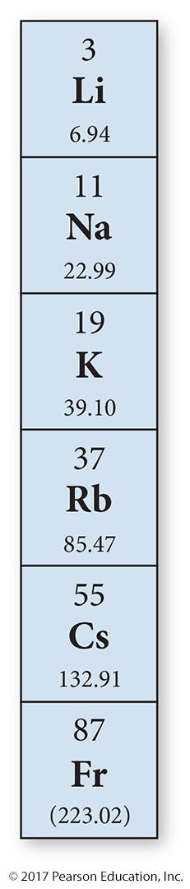
Nerve Signal Transmission
Movement of ions across cell membranes is the basis for the transmission of nerve signals.
Na⁺ and K⁺ ions are pumped across membranes in opposite directions through ion channels.
  Na⁺ out and K⁺ in
The ion channels can differentiate Na⁺ from K⁺ by their difference in size.
Ion size and other properties of atoms are periodic properties—properties whose values can be predicted based on the element’s position on the periodic table.

Slide 3

Mendeleev (1834–1907)
Ordered elements by atomic mass
Saw a repeating pattern of properties
Periodic law: When the elements are
arranged in order of increasing atomic
mass, certain sets of properties recur
periodically.
Put elements with similar properties in the same column
Used pattern to predict properties of undiscovered elements
Where atomic mass order did not fit other properties, he reordered by other properties.
  Te and I

Slide 4
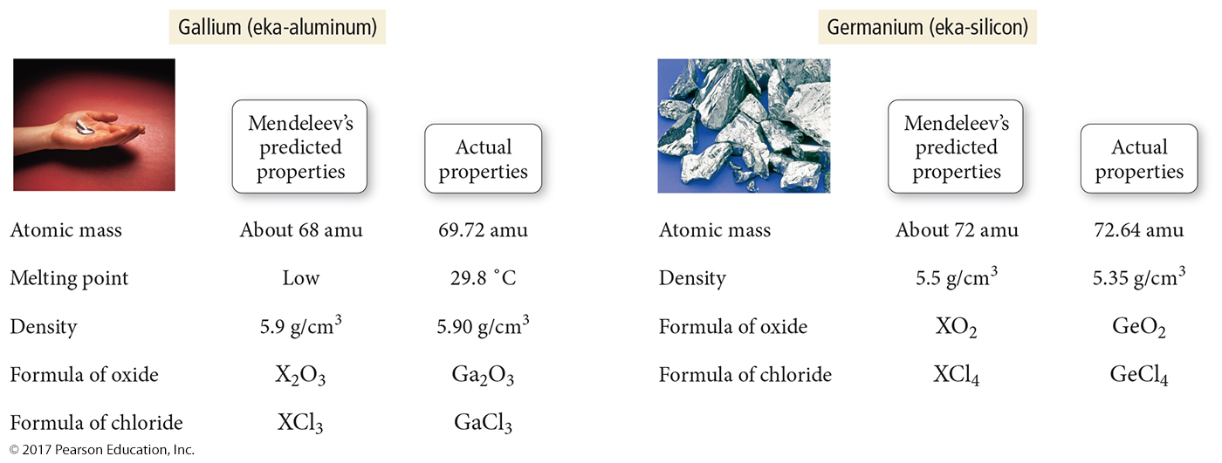
Mendeleev’s Predictions

Slide 5
What versus Why
Mendeleev’s periodic law allows us to predict what the properties of an element will be based on its position on the table.
It doesn’t explain why the pattern exists.
Quantum mechanics is a theory that explains why the periodic trends in the properties exist.
  Knowing why allows us to predict what.

Slide 6
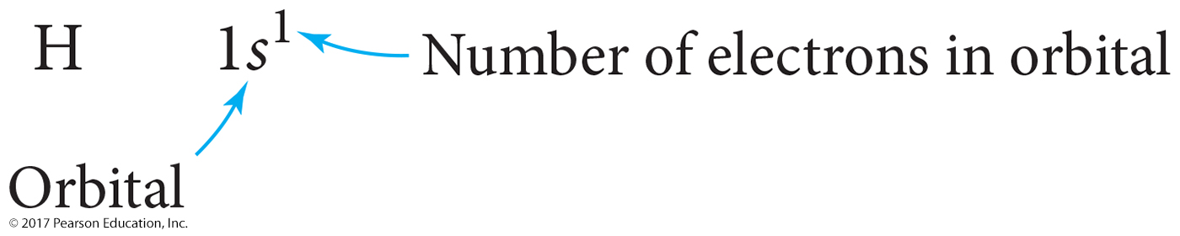
Electron Configurations
Quantum-mechanical theory describes the behavior of electrons in atoms.
The electrons in atoms exist in orbitals.
A description of the orbitals occupied by electrons is called an electron configuration.

Slide 7
How Electrons Occupy Orbitals
Calculations with Schrödinger’s equation show that hydrogen’s one electron occupies the lowest energy orbital in the atom.
Schrödinger’s equation calculations for multielectron atoms cannot be exactly solved.
  Due to additional terms added for electron–electron interactions
Approximate solutions show the orbitals to be
hydrogen-like.
Two additional concepts affect multielectron atoms: electron spin and energy splitting of sublevels.

Slide 8
Electron Spin
Experiments by Stern and Gerlach showed that a beam of silver atoms is split in two by a magnetic field.
The experiment reveals that the electrons spin on their axis.
As they spin, they generate a magnetic field.
  Spinning charged particles generates a magnetic field.
If there is an even number of electrons, about half the atoms will have a net magnetic field pointing “north” and the other half will have a net magnetic field pointing “south.”

Slide 9
The Property of Electron Spin
Spin is a fundamental property of all electrons.
All electrons have the same amount of spin.
The orientation of the electron spin is quantized; it can be in only one direction or its opposite.
  Spin up or spin down
The electron’s spin adds a fourth quantum number to the description of electrons in an atom, called the spin quantum number, m_{s}.
  Not in the Schrödinger equation

Slide 10
Spin Quantum Number, m_{s}, and Orbital Diagrams
m_{s} can have values of +½ or −½.
Orbital diagrams use a square to represent each orbital and a half-arrow to represent each electron in the orbital.
By convention, a half-arrow pointing up is used to represent an electron in an orbital with spin up.
Spins must cancel in an orbital.
  Paired

Slide 11
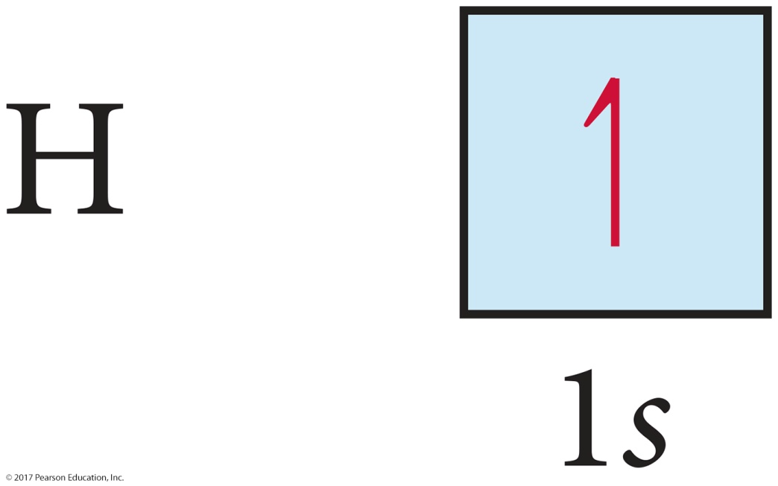
Orbital Diagrams
We often represent an orbital as a square and the electrons in that orbital as arrows.
  The direction of the arrow represents the spin of the electron.

Slide 12
Pauli Exclusion Principle
No two electrons in an atom may have the same set of four quantum numbers.
Therefore, no orbital may have more than two electrons, and they must have opposite spins.

Slide 13
Pauli Exclusion Principle
Knowing the number of orbitals in a sublevel allows us to determine the maximum number of electrons in the sublevel:
  s sublevel has 1 orbital; therefore, it can hold
  2 electrons.
  p sublevel has 3 orbitals; therefore, it can hold
  6 electrons.
  d sublevel has 5 orbitals; therefore, it can hold
  10 electrons.
  f sublevel has 7 orbitals; therefore, it can hold
  14 electrons.

Slide 14
Quantum Numbers of Helium’s Electrons
Helium has two electrons.
Both electrons are in the first energy level.
Both electrons are in the s orbital of the first
energy level.
Because they are in the same orbital, they must have opposite spins.

Slide 15
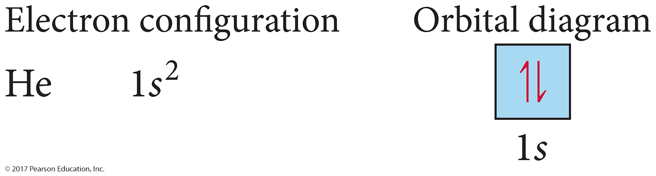
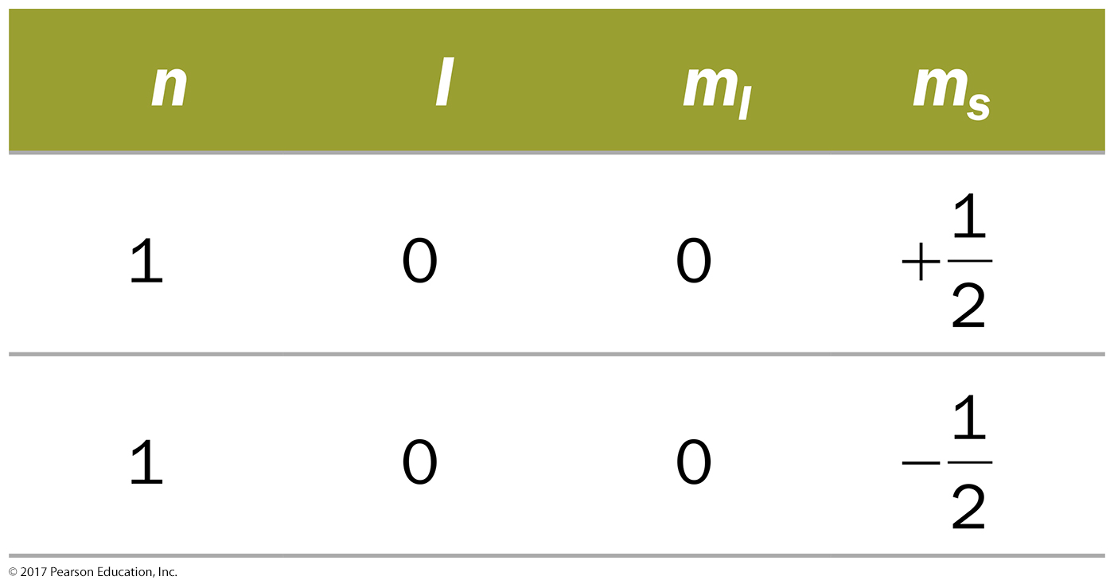
Allowed Quantum Numbers

Slide 16
Sublevel Splitting in Multielectron Atoms
The sublevels in each principal energy shell of hydrogen all have the same energy or other single electron systems.
We call orbitals with the same energy degenerate.
For multielectron atoms, the energies of the sublevels are split.
  Caused by charge interaction, shielding, and penetration
The lower the value of the l quantum number, the less energy the sublevel has.
  s (l = 0) < p (l = 1) < d (l = 2) < f (l = 3)

Slide 17
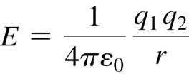
Coulomb’s Law
Coulomb’s law describes the attractions and repulsions between charged particles.
For like charges, the potential energy (E) is positive and decreases as the particles get farther apart as r increases.
For opposite charges, the potential energy is negative and becomes more negative as the particles get closer together.
The strength of the interaction increases as the size of the charges increases.
  Electrons are more strongly attracted to a nucleus with a 2+ charge than a nucleus with a 1+ charge.

Slide 18
Shielding and Effective Nuclear Charge
Each electron in a multielectron atom experiences both the attraction to the nucleus and the repulsion by other electrons in the atom.
These repulsions cause the electron to have a net reduced attraction to the nucleus; it is shielded from the nucleus.
The total amount of attraction that an electron feels for the nucleus is called the effective nuclear charge of the electron.

Slide 19
Penetration
The closer an electron is to the nucleus, the more attraction it experiences.
The better an outer electron is at penetrating through the electron cloud of inner electrons, the more attraction it will have for the nucleus.
The degree of penetration is related to the orbital’s radial distribution function.
  In particular, the distance the maxima of the function are from the nucleus

Slide 20
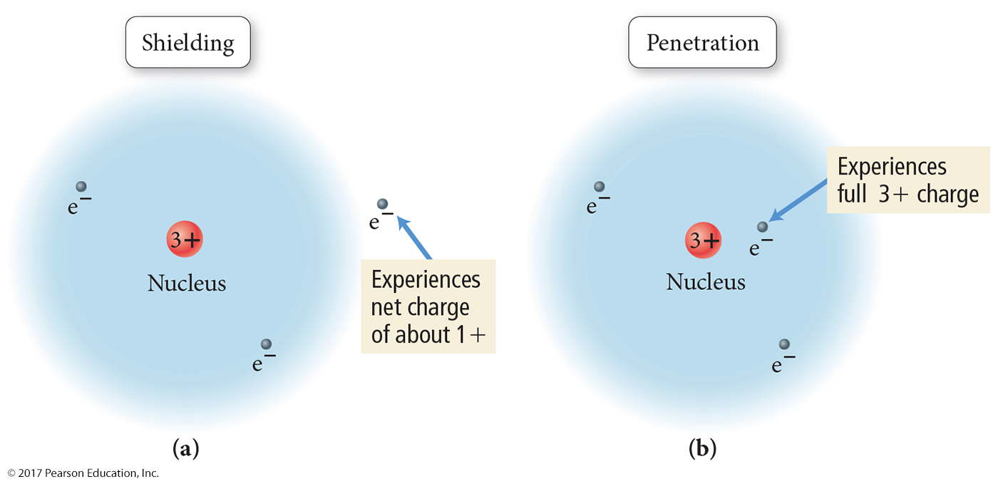
Shielding and Penetration

Slide 21
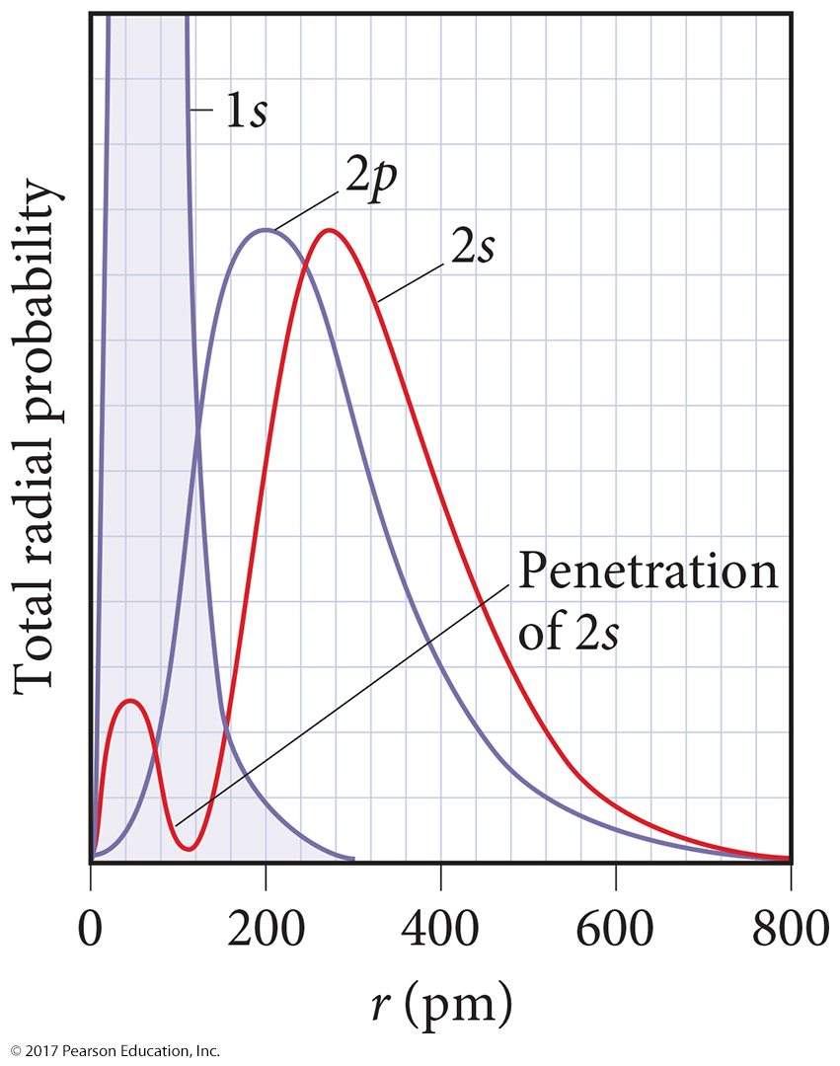
Penetration and Shielding
The radial distribution function shows that the 2s orbital penetrates more deeply into the 1s orbital than does the 2p.
The weaker penetration of the
2p sublevel means that electrons in the 2p sublevel experience more repulsive force; they are more shielded from the attractive force of the nucleus.
The deeper penetration of the
2s electrons means electrons in the 2s sublevel experience a greater attractive force to the nucleus and are not shielded as effectively.

Slide 22
Effect of Penetration and Shielding
Penetration causes the energies of sublevels in the same principal level to not be degenerate.
In the fourth and fifth principal levels, the effects of penetration become so important that the s orbital lies lower in energy than the d orbitals of the previous principal level.
The energy separations between one set of orbitals and the next become smaller beyond
the 4s.
  The ordering can therefore vary among elements, causing variations in the electron configurations of the transition metals and their ions.

Slide 23
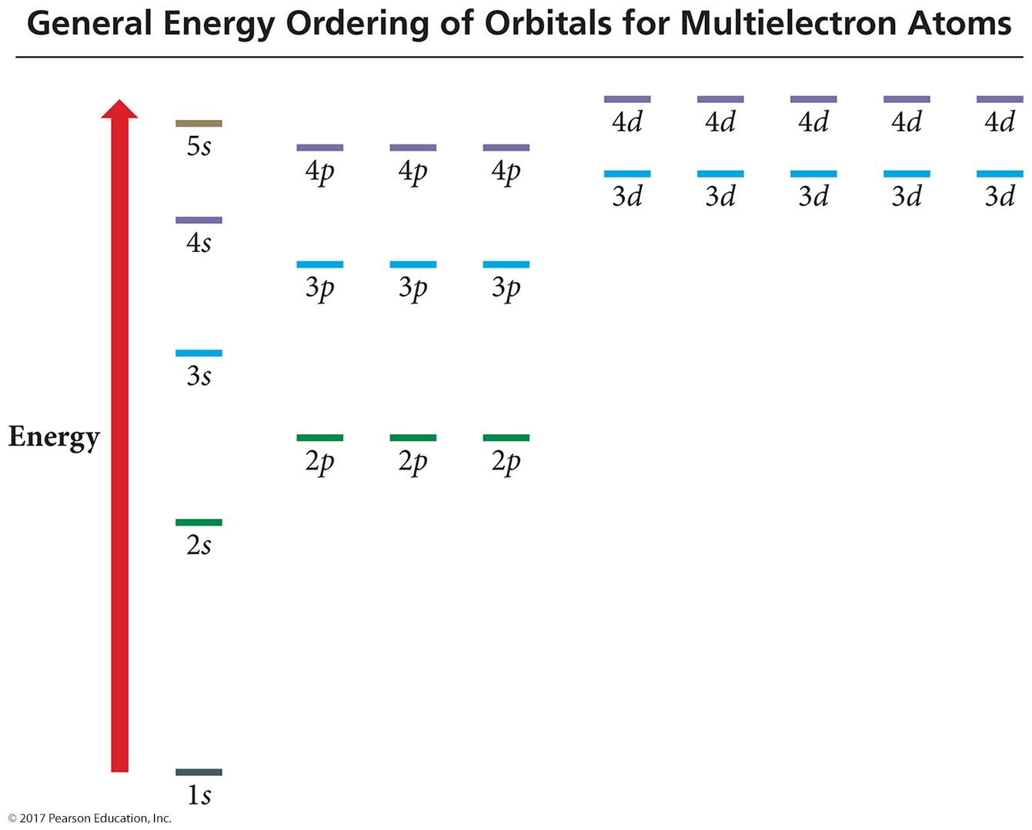

Slide 24
Filling the Orbitals with Electrons
Energy levels and sublevels fill from lowest energy to highest:
  s → p → d → f
  Aufbau principle
Orbitals that are in the same sublevel have the same energy.
No more than two electrons per orbital
  Pauli exclusion principle
When filling orbitals that have the same energy, place one electron in each before completing pairs.
  Hund’s rule

Slide 25
Electron Configuration of Atoms in Their Ground State
The electron configuration is a listing of the sublevels in order of filling with the number of electrons in that sublevel written as a superscript.
Kr = 36 electrons = 1s²2s²2p⁶3s²3p⁶4s²3d¹⁰4p⁶
A short-hand way of writing an electron configuration is to use the symbol of the previous noble gas in brackets [] to represent all the inner electrons and then just write the last set.
Rb = 37 electrons = 1s²2s²2p⁶3s²3p⁶4s²3d¹⁰4p⁶5s¹ = [Kr]5s¹

Slide 26
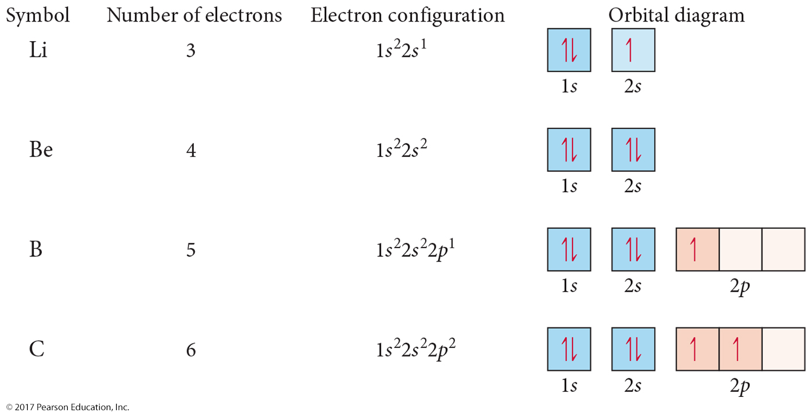
Electron Configurations

Slide 27
Valence Electrons
The electrons in all the sublevels with the highest principal energy shell are called the valence electrons.
Electrons in lower energy shells are called core electrons.
One of the most important factors in the way an atom behaves, both chemically and physically, is the number of valence electrons.

Slide 28
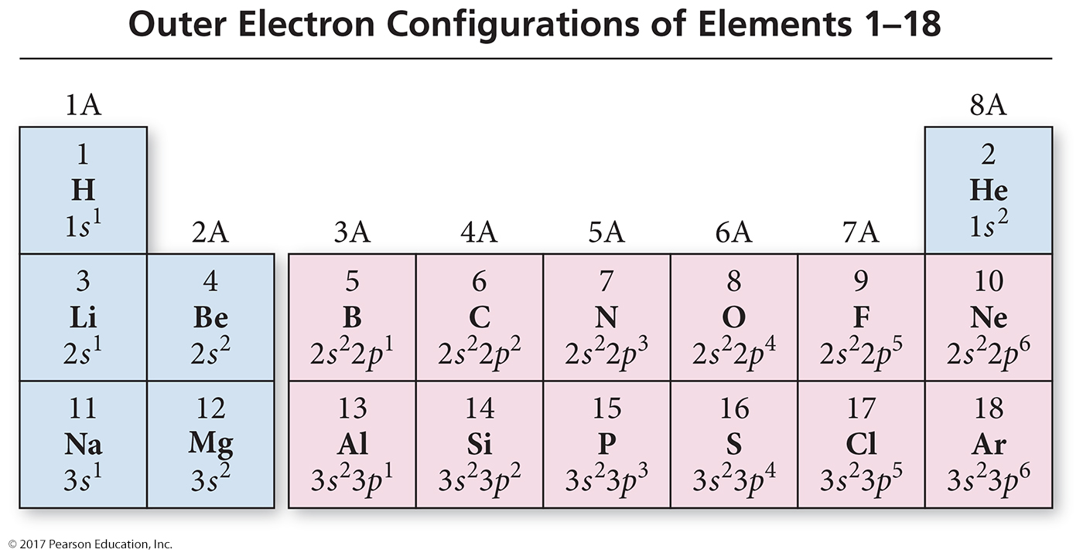

Slide 29
Electron Configuration and the
Periodic Table
The group number corresponds to the number of valence electrons.
The length of each “block” is the maximum number of electrons the sublevel can hold.
The period number corresponds to the principal energy level of the valence electrons.

Slide 30
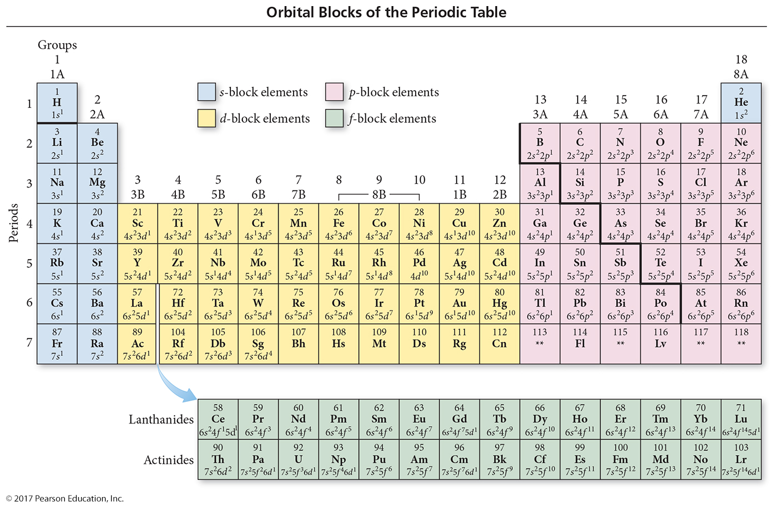

Slide 31
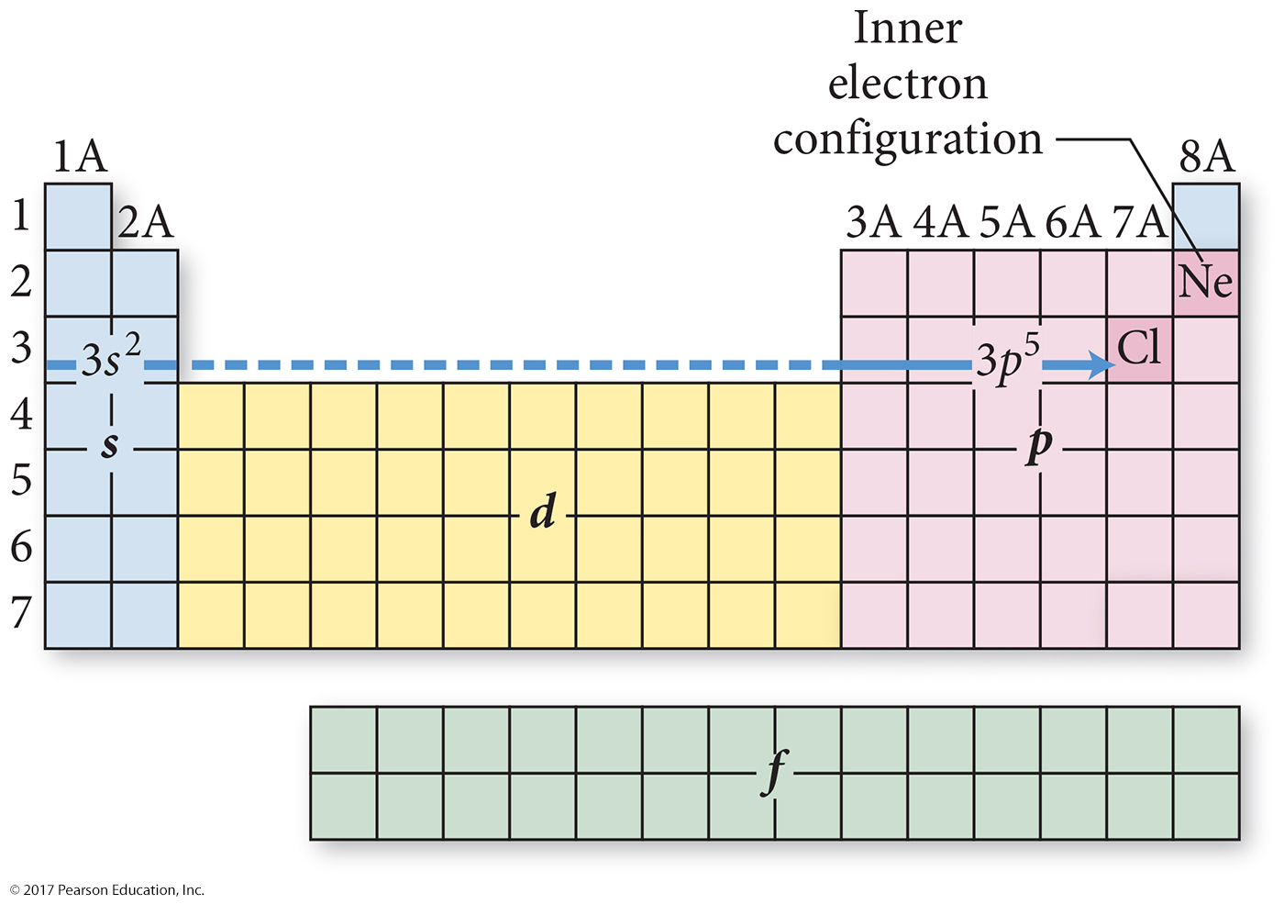

Slide 32
Irregular Electron Configurations
We know that, because of sublevel splitting, the 4s sublevel is lower in energy than the 3d; therefore, the 4s fills before the 3d.
But the difference in energy is not large.
Some of the transition metals have irregular electron configurations in which the ns only partially fills before the (n−1)d or doesn’t fill at all.
Therefore, their electron configuration must be found experimentally.

Slide 33
Irregular Electron Configurations
Expected
Cr = [Ar]4s²3d⁴
Cu = [Ar]4s²3d⁹
Mo = [Kr]5s²4d⁴
Ru = [Kr]5s²4d⁶
Pd = [Kr]5s²4d⁸
Found experimentally
Cr = [Ar]4s¹3d⁵
Cu = [Ar]4s¹3d¹⁰
Mo = [Kr]5s¹4d⁵
Ru = [Kr]5s¹4d⁷
Pd = [Kr]5s⁰4d¹⁰

Slide 34
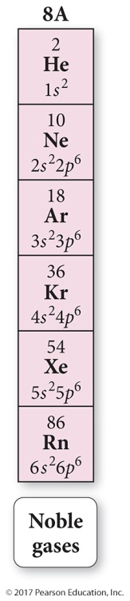
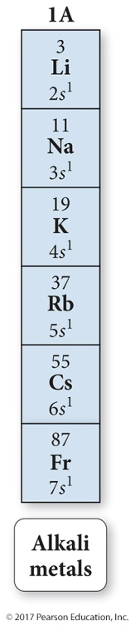
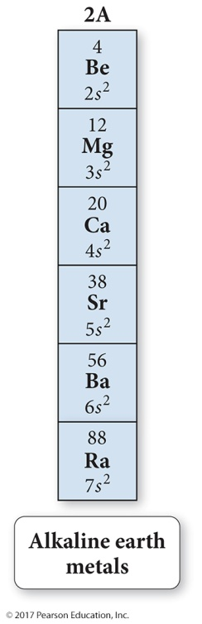
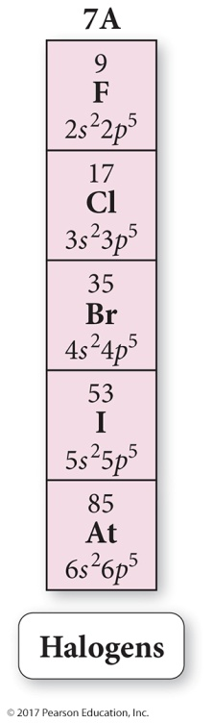
Properties and Electron Configuration
The properties of the elements follow a periodic pattern.
  Elements in the same column have similar properties.
  The elements in a period show a pattern that repeats.
The quantum-mechanical model explains this because the number of valence electrons and the types of orbitals they occupy are also periodic.

Slide 35
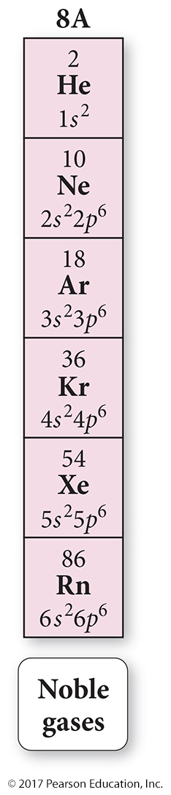
The Noble Gas Electron Configuration
The noble gases have eight valence electrons.
  Except for He, which has only two electrons
They are especially nonreactive.
  He and Ne are practically inert.
The reason the noble gases are so nonreactive is that the electron configuration of the noble gases is especially stable.

Slide 36
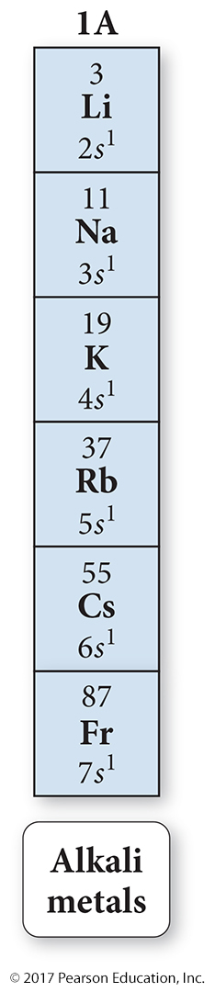
The Alkali Metals
The alkali metals have one more electron than the previous noble gas.
In their reactions, the alkali metals tend to lose one electron, resulting in the same electron configuration as a noble gas.
  Forming a cation with a 1+ charge

Slide 37
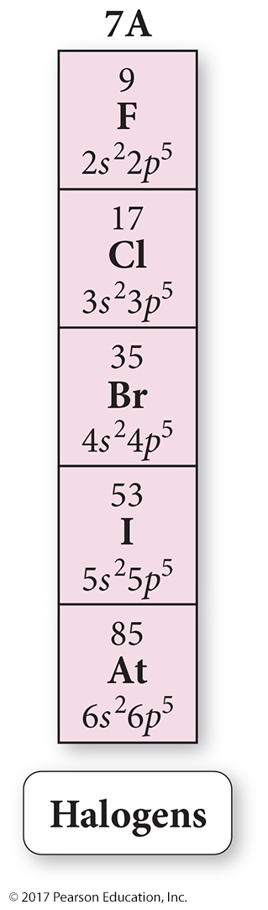
The Halogens
Have one fewer electron than the next
noble gas
In their reactions with metals, the halogens tend to gain an electron and attain the electron configuration of the next noble gas, forming an anion with charge 1−.
In their reactions with nonmetals, they tend to share electrons with the other nonmetal so that each attains the electron configuration of a noble gas.

Slide 38
Electron Configuration and Ion Charge
We have seen that many metals and nonmetals form one ion and that the charge on that ion is predictable based on its position on the periodic table.
  Group 1A = 1+, group 2A = 2+, group 7A = 1−,
  group 6A = 2−, etc.
These atoms form ions that will result in an electron configuration that is the same as the nearest noble gas.

Slide 39
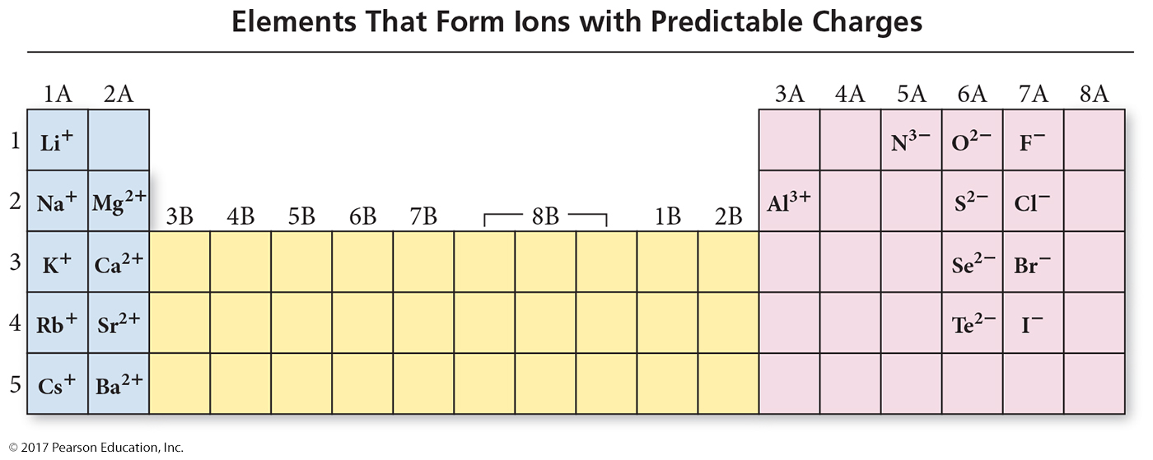

Slide 40
Electron Configuration of Anions in Their Ground State
Anions are formed when nonmetal atoms gain enough electrons to have eight valence electrons.
  Filling the s and p sublevels of the valence shell
The sulfur atom has six valence electrons.
  S atom = 1s²2s²2p⁶3s²3p⁴
To have eight valence electrons, sulfur must gain two more.
  S²⁻ anion = 1s²2s²2p⁶3s²3p⁶

Slide 41
Electron Configuration of Cations in Their Ground State
Cations are formed when a metal atom loses all its
valence electrons, resulting in a new lower energy level valence shell.
  However, the process is always endothermic.
The magnesium atom has two valence electrons.
  Mg atom = 1s²2s²2p⁶3s²
When magnesium forms a cation, it loses its valence electrons.
  Mg²⁺ cation = 1s²2s²2p⁶

Slide 42
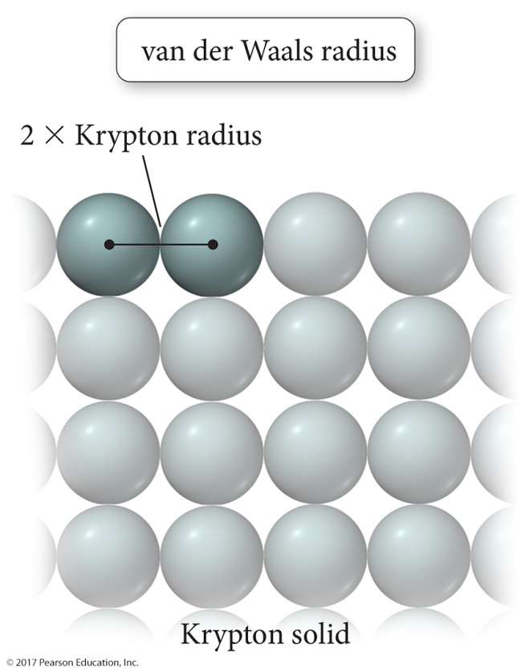
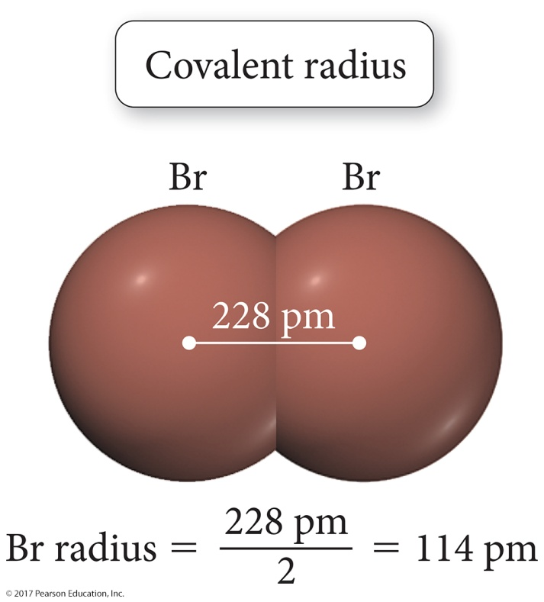
Trend in Atomic Radius: Main Group
There are several methods for measuring the radius of an atom, and they give slightly different numbers.
  Van der Waals radius = nonbonding
  Covalent radius = bonding radius
  Atomic radius is an average radius of an atom based on measuring large numbers of elements and compounds.

Slide 43
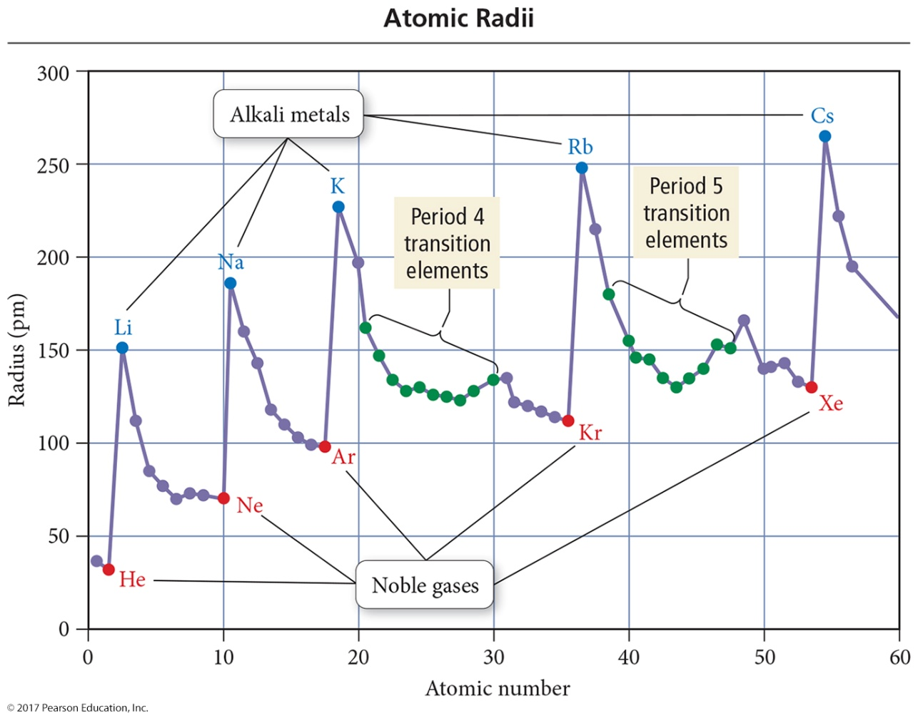
Trend in Atomic Radius: Main Group
Atomic radius decreases across period (left to right).
  Adding electrons to same valence shell
  Effective nuclear charge increases
  Valence shell held closer

Slide 44
Trend in Atomic Radius: Main Group
Atomic radius increases down group.
  Valence shell farther from nucleus
  Effective nuclear charge fairly close

Slide 45
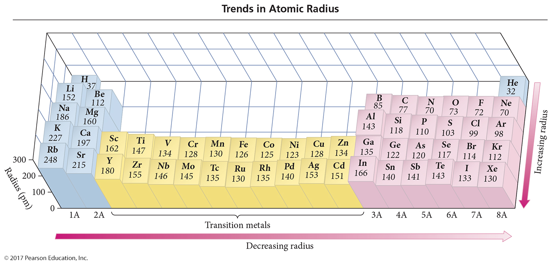
Periodic Trends in Atomic Radius

Slide 46
Shielding
In a multielectron system, electrons are simultaneously attracted to the nucleus and repelled by each other.
Outer electrons are shielded from the nucleus by the core electrons.
  Screening or shielding effect
  Outer electrons do not effectively screen for each other.
The shielding causes the outer electrons to not experience the full strength of the nuclear charge.

Slide 47
Effective Nuclear Charge
The effective nuclear charge is a net positive charge that is attracting a particular electron.
Z is the nuclear charge, and S is the number of electrons in lower energy levels.
  Electrons in the same energy level contribute to screening, but since their contribution is so small they are not part of the calculation.
  Trend is s > p > d > f.
Z_{effective} = Z − S

Slide 48
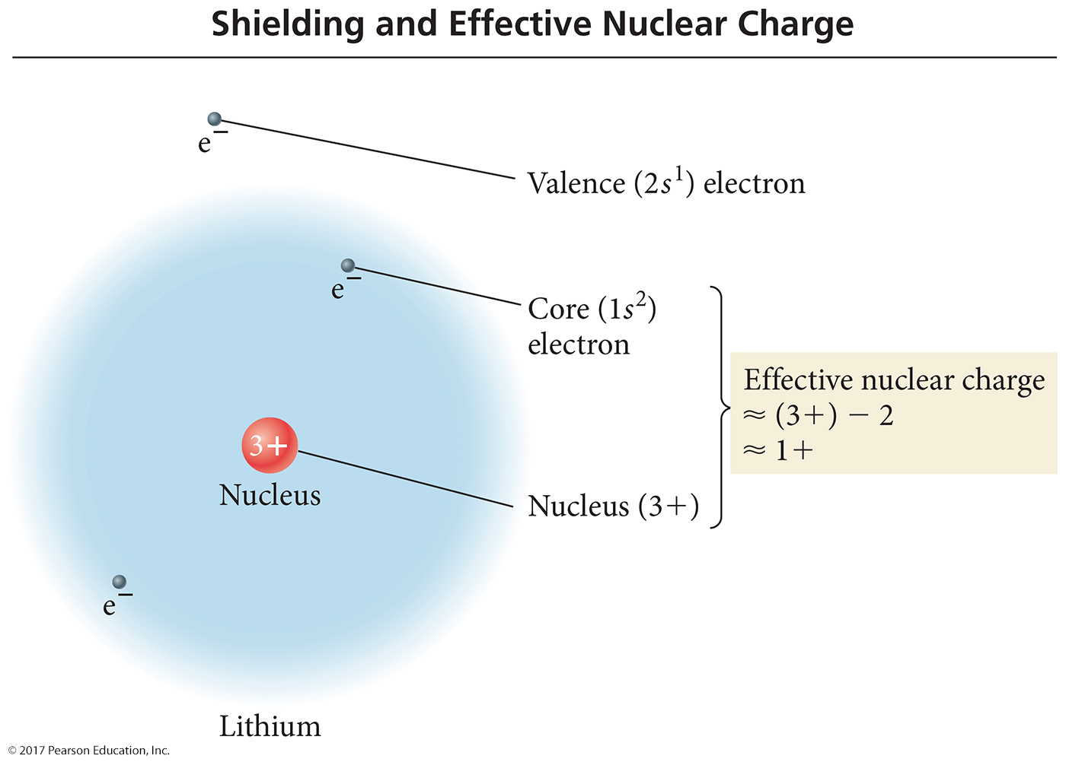
Screening and Effective Nuclear Charge

Slide 49
Quantum-Mechanical Explanation for the Group Trend in Atomic Radius
The size of an atom is related to the distance the valence electrons are from the nucleus.
The larger the orbital an electron is in, the farther its most probable distance will be from the nucleus and the less attraction it will have for the nucleus.

Slide 50
Quantum-Mechanical Explanation for the Group Trend in Atomic Radius
Traversing down a group adds a principal energy level.
The larger the principal energy level an orbital is in, the larger its volume.
Quantum-mechanics predicts the atoms should get larger down a column.

Slide 51
Quantum-Mechanical Explanation for the Period Trend in Atomic Radius
The larger the effective nuclear charge an electron experiences, the stronger the attraction it will have for the nucleus.
The stronger the attraction the valence electrons have for the nucleus, the closer their average distance will be to the nucleus.
Traversing across a period increases the effective nuclear charge on the valence electrons.
Quantum-mechanics predicts the atoms should get smaller across a period.

Slide 52
Trends in Atomic Radius: Transition Metals
Atoms in the same group increase in size down the column.
Atomic radii of transition metals are roughly the same size across the d block.
  Much less difference than across main-group elements
  Valence shell ns², not the (n−1)d electrons
  Effective nuclear charge on the ns² electrons approximately the same

Slide 53
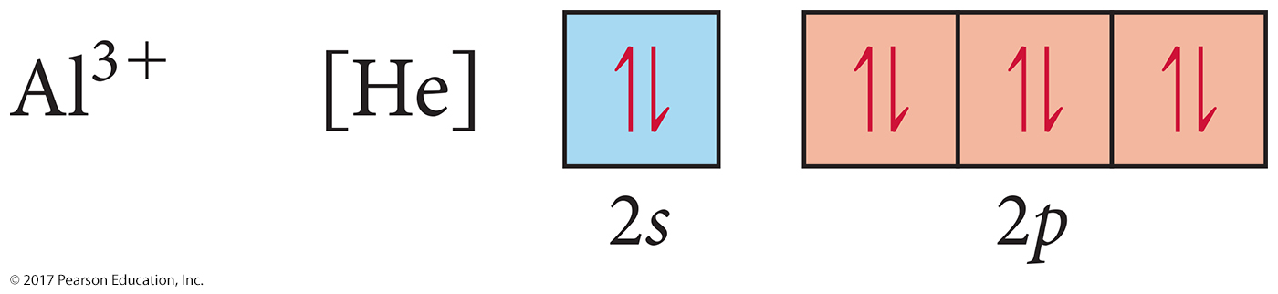
Electron Configurations of Main Group Cations in Their Ground State
Cations form when the atom loses electrons from the valence shell.
Al atom = 1s²2s²2p⁶3s²3p¹
Al³⁺ ion = 1s²2s²2p⁶

Slide 54

Electron Configurations of Transition Metal Cations in Their Ground State
When transition metals form cations, the first electrons removed are the valence electrons, even though other electrons were added after.
Electrons may also be removed from the sublevel closest to the valence shell after the valence electrons.
The iron atom has two valence electrons:
  Fe atom = 1s²2s²2p⁶3s²3p⁶4s²3d⁶
When iron forms a cation, it first loses its valence electrons:
  Fe²⁺ cation = 1s²2s²2p⁶3s²3p⁶3d⁶
It can then lose 3d electrons:
  Fe³⁺ cation = 1s²2s²2p⁶3s²3p⁶3d⁵

Slide 55
Magnetic Properties of Transition Metal Atoms and Ions
Electron configurations that result in unpaired electrons mean that the atom or ion will have a net magnetic field; this is called paramagnetism.
  Will be attracted to a magnetic field
Electron configurations that result in all paired electrons mean that the atom or ion will have no magnetic field; this is called diamagnetism.
  Slightly repelled by a magnetic field

Slide 56
Trends in Ionic Radius
Ions in the same group have the same charge.
Ion size increases down the column.
  Higher valence shell, larger ion
Cations are smaller than neutral atoms; anions are larger than neutral atoms.
Cations are smaller than anions.
  Except Rb⁺ and Cs⁺, bigger or same size as F⁻ and O²⁻
Larger positive charge = smaller cation
  For isoelectronic species
  Isoelectronic = same electron configuration
Larger negative charge = larger anion
  For isoelectronic species

Slide 57
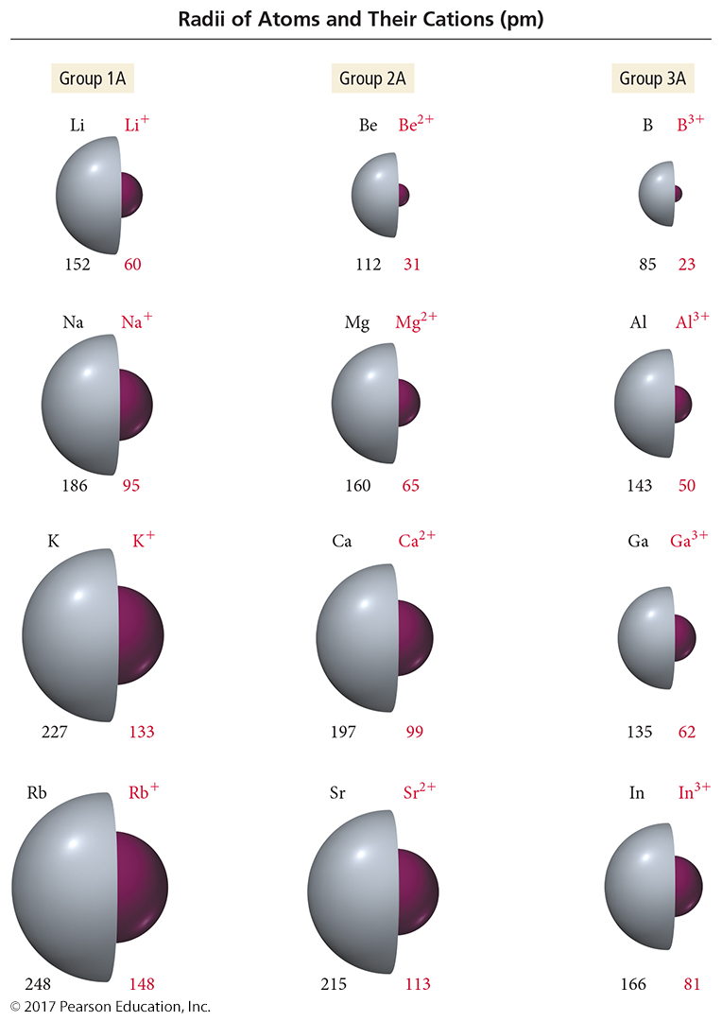
Periodic Trends in Ionic Radius

Slide 58
Explanation for the Trends in Cation Radius
When atoms form cations, the valence electrons are removed.
The farthest electrons from the nucleus are the p or d electrons in the (n − 1) energy level.
This results in the cation being smaller than the atom.

Slide 59
Explanation for the Trends in Cation Radius
These “new valence electrons” also experience a larger effective nuclear charge than the “old valence electrons,” shrinking the ion even more.
Traversing down a group increases the (n − 1) level, causing the cations to get larger.
Traversing to the right across a period increases the effective nuclear charge for isoelectronic cations, causing the cations to get smaller.

Slide 60
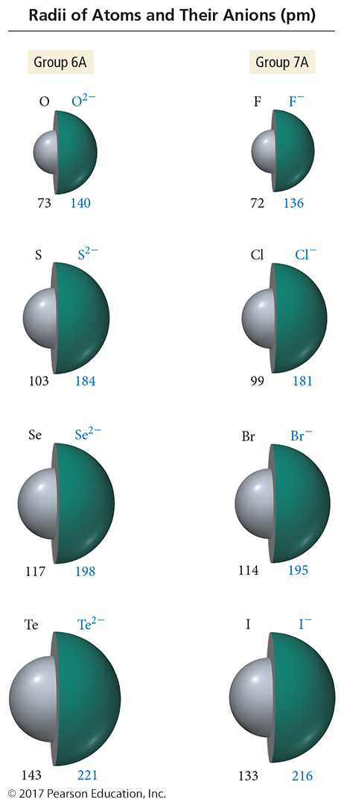
Periodic Trends in Anionic Radius

Slide 61
Explanation for the Trends in Anion Radius
When atoms form anions, electrons are added to the valence shell.
These “new valence electrons” experience a smaller effective nuclear charge than the “old valence electrons,” increasing the size.
The result is that the anion is larger than the atom.

Slide 62
Explanation for the Trends in Anion Radius
Traversing down a group increases the n level, causing the anions to get larger.
Traversing to the right across a period decreases the effective nuclear charge for isoelectronic anions, causing the anions to get larger.

Slide 63
Ionization Energy (IE)
Minimum energy needed to remove an electron from an atom or ion
  Gas state
  Endothermic process
  Valence electron easiest to remove, lowest IE
  M(g) + IE₁ → M¹⁺(g) + 1 e–
  M⁺¹(g) + IE₂ → M²⁺(g) + 1 e–
    First ionization energy = energy to remove electron from neutral atom
    Second IE = energy to remove electron from 1+ ion, etc.

Slide 64
General Trends in First Ionization Energy
The larger the effective nuclear charge on the electron, the more energy it takes to remove it.
The farther the most probable distance the electron is from the nucleus, the less energy it takes to remove it.
First IE decreases down the group.
  Valence electron farther from nucleus
First IE generally increases across the period.
  Effective nuclear charge increases

Slide 65
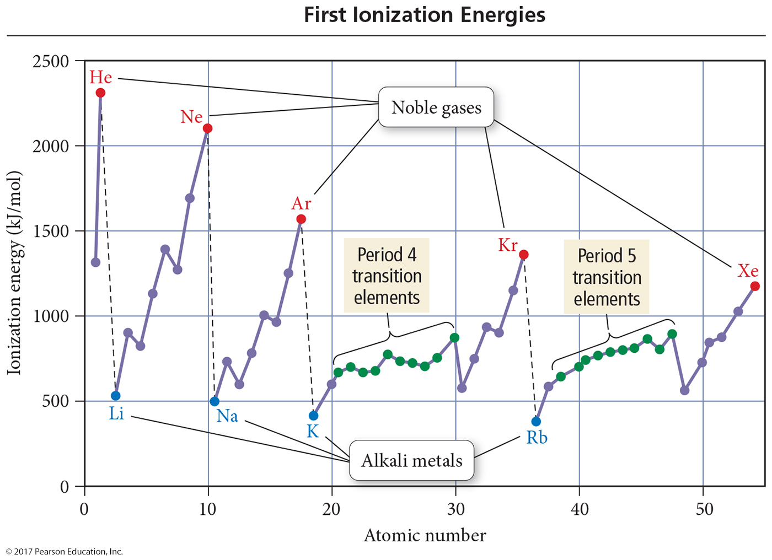

Slide 66
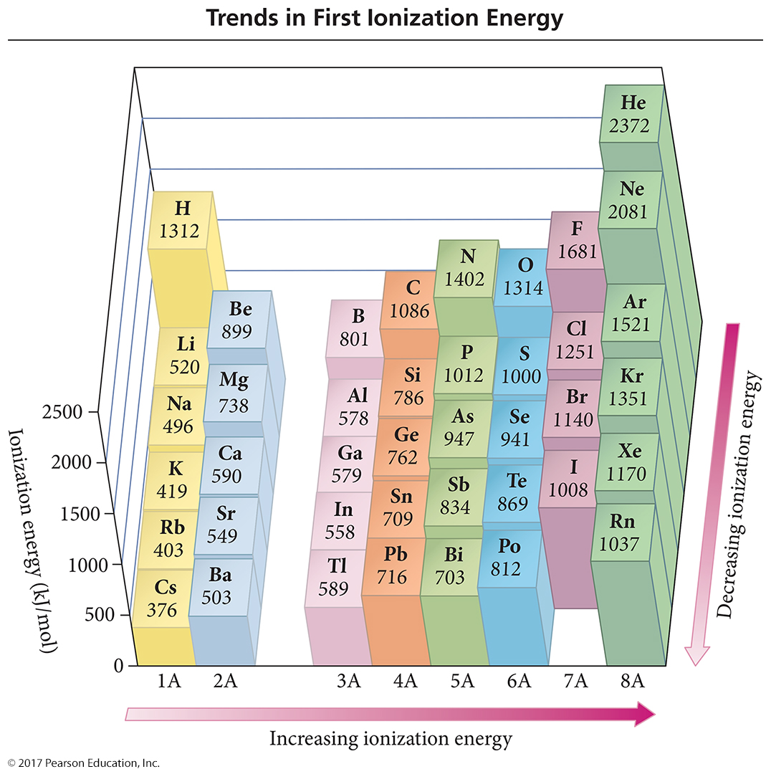

Slide 67
Explanation for the Trends in First Ionization Energy
The strength of attraction is related to the most probable distance the valence electrons are from the nucleus and the effective nuclear charge the valence electrons experience.
The larger the orbital an electron is in, the farther its most probable distance will be from the nucleus and the less attraction it will have for the nucleus.
Quantum-mechanics predicts the atom’s first ionization energy should get lower down a column.

Slide 68
Explanation for the Trends in First Ionization Energy
Traversing across a period increases the effective nuclear charge on the valence electrons.
Quantum-mechanics predicts the atom’s first ionization energy should get larger across a period.

Slide 69
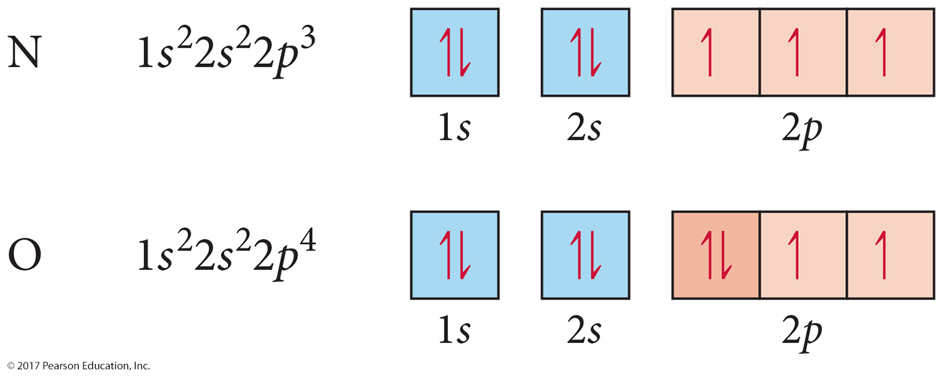
Exceptions in the First IE Trends
First ionization energy generally increases from left to right across a period.
Except from 2A to 3A and 5A to 6A

Slide 70
Exceptions in the First Ionization Energy Trends, N and O
To ionize N, you must break up a half-full sublevel, which costs extra energy.
When you ionize O, you get a half-full sublevel, which costs less energy.

Slide 71
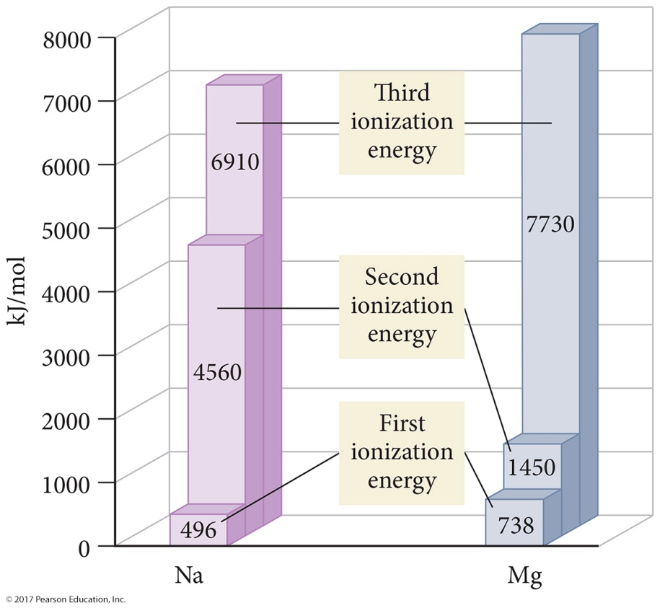
Trends in Successive Ionization Energies
Removal of each successive electron costs more energy.
  Shrinkage in size due to having more protons than electrons
  Outer electrons closer to
  the nucleus; therefore
  harder to remove
There’s a regular increase in energy for each successive valence electron.
There’s a large increase in energy when core electrons are removed.

Slide 72
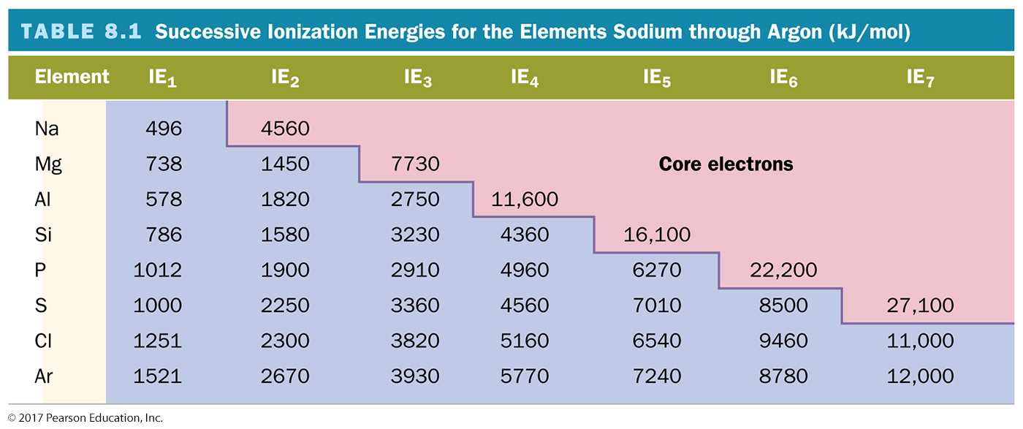
Trends in Second and Successive Ionization Energies

Slide 73
Electron Affinity
Energy is released when a neutral atom gains an electron.
  Gas state
  M(g) + 1e⁻ → M¹⁻(g) + EA
Electron affinity is defined as exothermic (−)
but may actually be endothermic (+).
  Some alkali earth metals and all noble gases are endothermic. Why?
The more energy that is released, the larger the electron affinity.
  The more negative the number, the larger the EA.

Slide 74
Trends in Electron Affinity
Alkali metals decrease electron affinity down the column.
  But not all groups do
  Generally irregular increase in EA from second period
  to third period
“Generally” increases across period
  Becomes more negative from left to right
  Not absolute
  Group 5A generally lower EA than expected because extra electron must pair
  Groups 2A and 8A generally very low EA because added electron goes into higher energy level or sublevel
Highest EA in any period = halogen

Slide 75
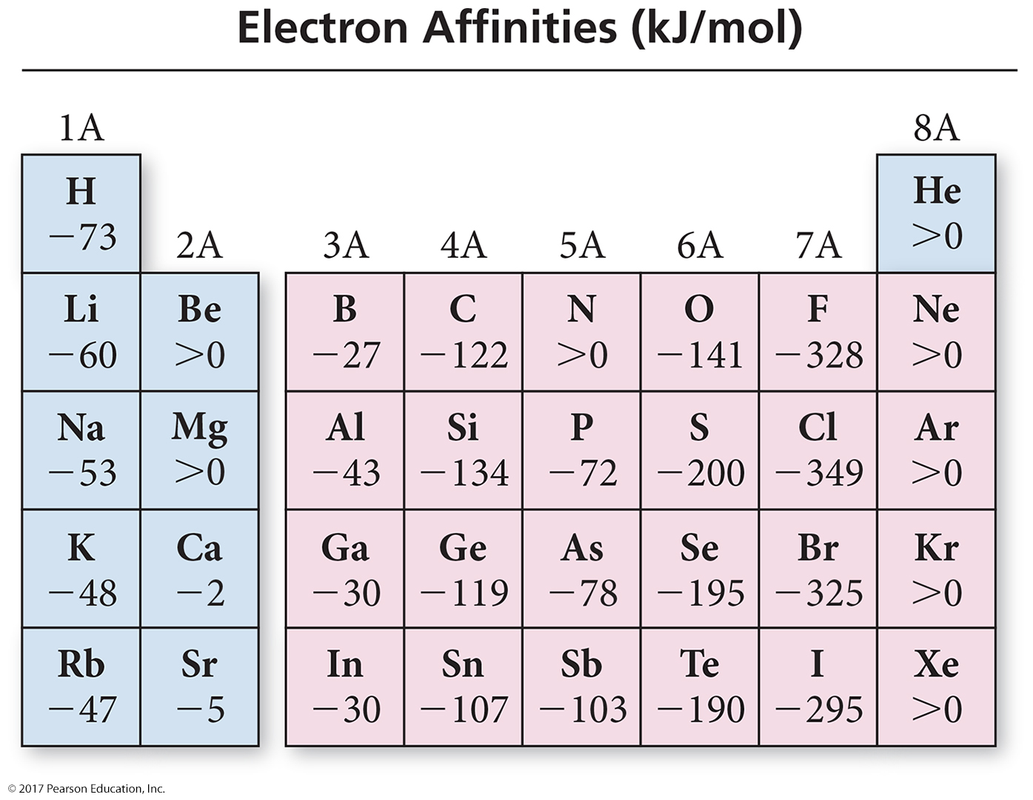

Slide 76
Properties of Metals and Nonmetals
Metals
  Malleable and ductile
  Shiny, lustrous, reflect light
  Conduct heat and electricity
  Most oxides basic and ionic
  Form cations in solution
  Lose electrons in reactions—oxidized
Nonmetals
  Brittle in solid state
  Dull, nonreflective solid surface
  Electrical and thermal insulators
  Most oxides are acidic and molecular
  Form anions and polyatomic anions
  Gain electrons in reactions—reduced

Slide 77
Metallic Character
Metallic character is how closely an element’s properties match the ideal properties of a metal.
  More malleable and ductile, better conductors, and easier
  to ionize
Metallic character decreases left to right across a period.
  Metals found at the left of the period, and nonmetals to
  the right
Metallic character increases down the column.
  Nonmetals found at the top of the middle main-group elements, and metals found at the bottom

Slide 78
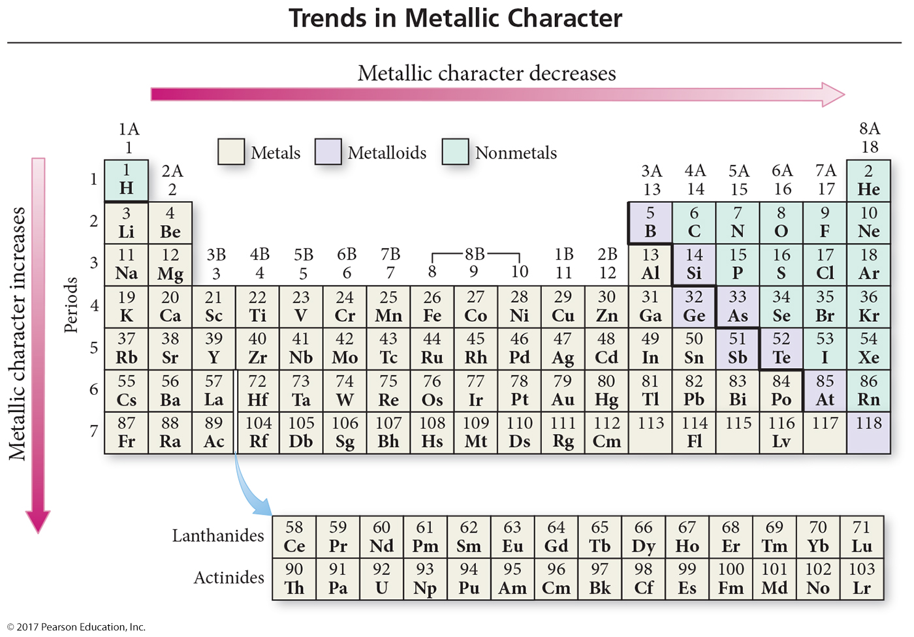

Slide 79
Explanation for the Trends in Metallic Character
Metals generally have smaller first ionization energies, and nonmetals generally have larger electron affinities.
  Except for the noble gases
∴ quantum mechanics predicts the atom’s metallic character should increase down a column because the valence electrons are not held as strongly.
∴ quantum mechanics predicts the atom’s metallic character should decrease across a period because the valence electrons are held more strongly and the electron affinity increases.

Slide 80
Trends in the Alkali Metals
Atomic radius increases down the column.
Ionization energy decreases down the column.
Very low ionization energies
  Good reducing agents; easy to oxidize
  Very reactive; not found uncombined in nature
  React with nonmetals to form salts
  Compounds generally soluble in water ∴ found in seawater
Electron affinity decreases down the column.
Melting point decreases down the column.
  All very low MP for metals
Density increases down the column.
  Except K
  In general, the increase in mass is greater than the increase in volume.

Slide 81
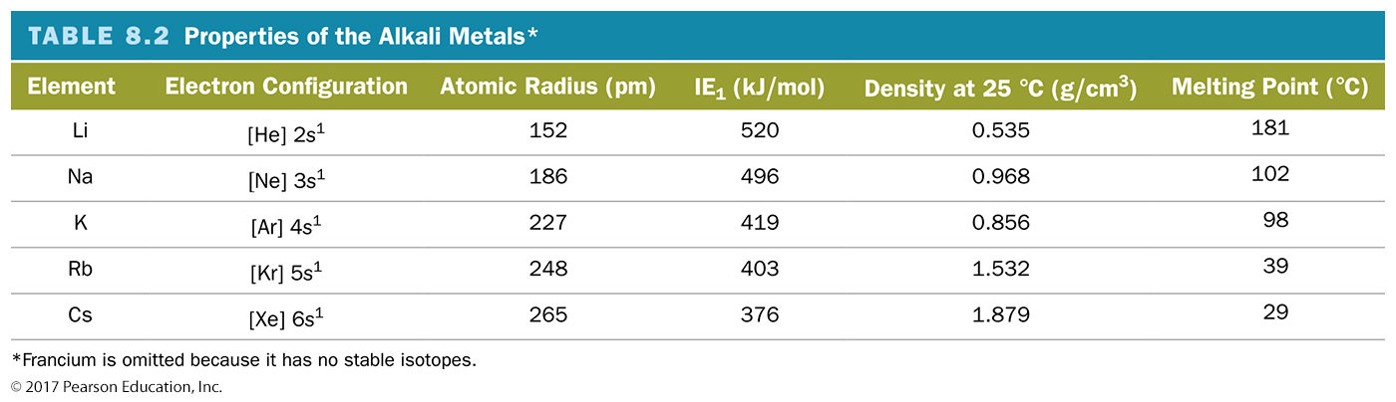
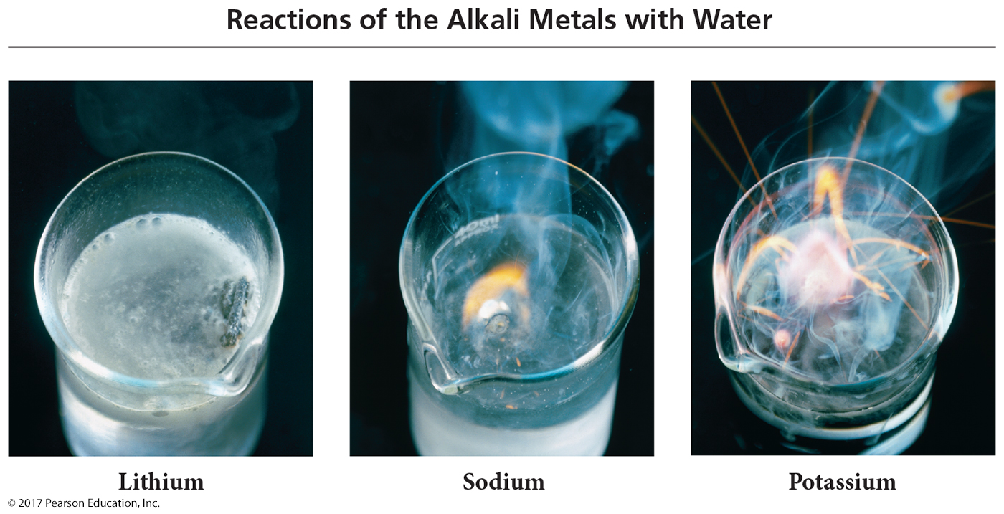
Alkali Metals

Slide 82
Trends in the Halogens
Atomic radius increases down the column.
Ionization energy decreases down the column.
Very high electron affinities
  Good oxidizing agents; easy to reduce
  Very reactive; not found uncombined in nature
  React with metals to form salts
  Compounds generally soluble in water ∴ found in seawater

Slide 83
Trends in the Halogens
Reactivity increases down the column.
They react with hydrogen to form HX, acids.
Melting point and boiling point increase down the column.
Density increases down the column.
  In general, the increase in mass is greater than the increase in volume.

Slide 84
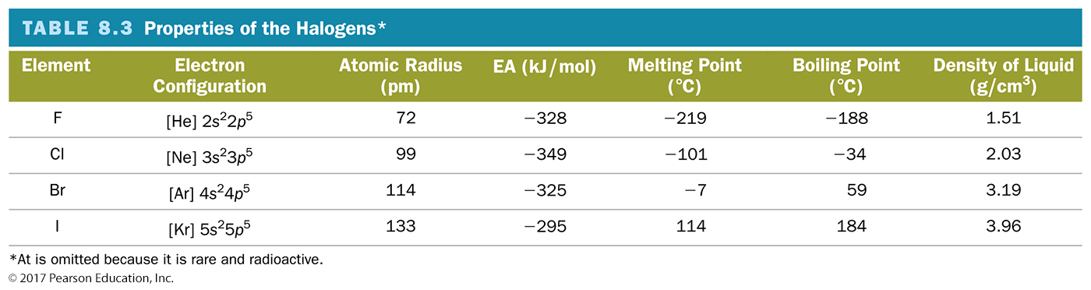
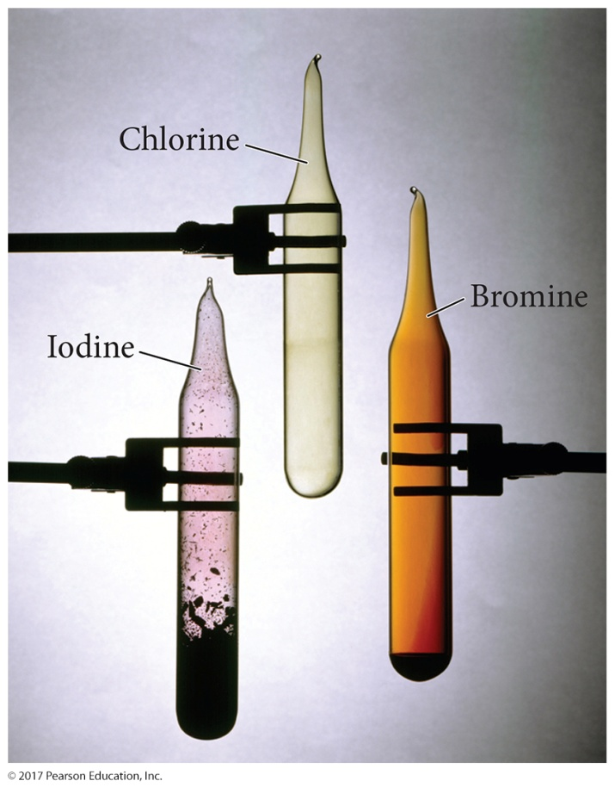
Halogens

Slide 85
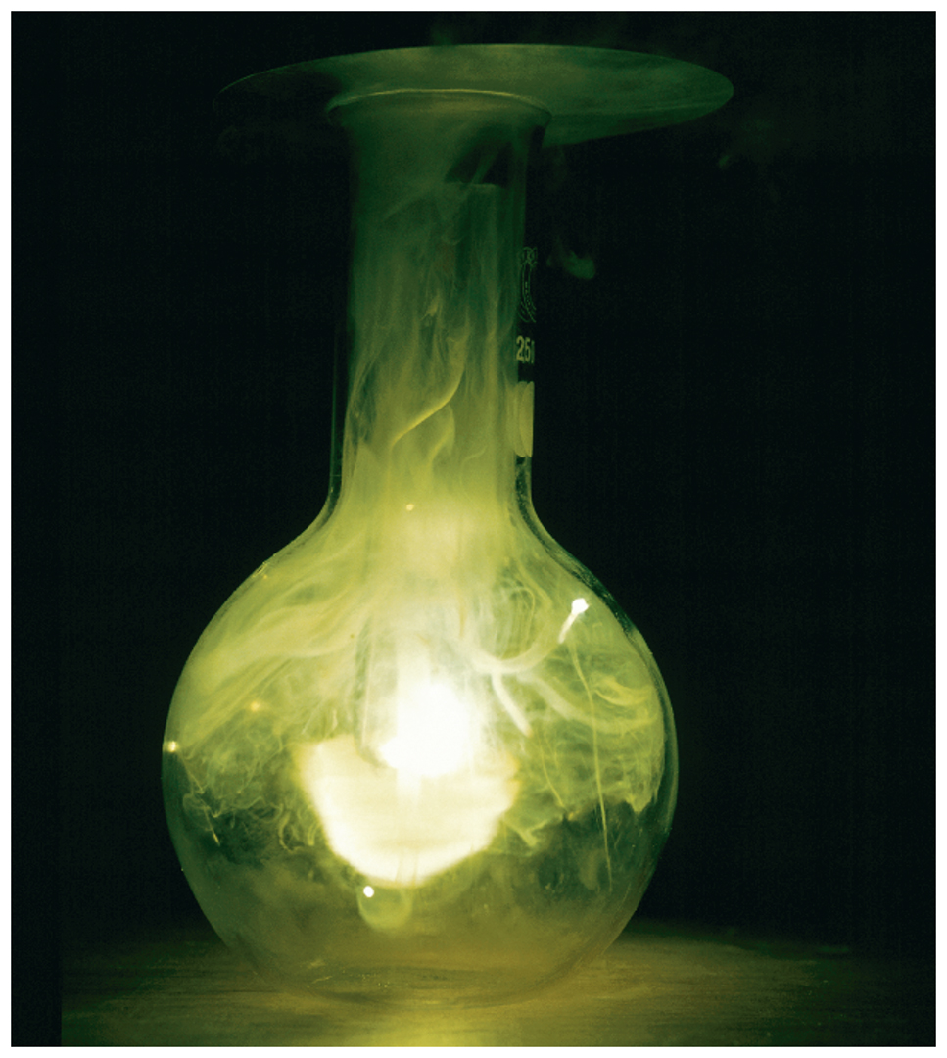
Reactions of Alkali Metals with Halogens
Alkali metals are oxidized to the 1+ ion.
Halogens are reduced to the 1− ion.
The ions then attach together by ionic bonds.
The reaction is exothermic.

Slide 86

Reactions of Alkali Metals with Water
Alkali metals are oxidized to the 1+ ion.
H₂O is split into H₂(g) and OH⁻ ion.
The Li, Na, and K are less dense than the water, so they float on top.
The ions then attach together by ionic bonds.
The reaction is exothermic, and often the heat released ignites the H₂(g).

Slide 87
Trends in the Noble Gases
Atomic radius increases down the column.
Ionization energy decreases down the column.
  Very high IE
Very unreactive
  Only found uncombined in nature
  Used as “inert” atmosphere when reactions with other gases would be undesirable

Slide 88
Trends in the Noble Gases
Melting point and boiling point increase down the column.
  All gases at room temperature
  Very low boiling points
Density increases down the column.
  In general, the increase in mass is greater than the increase in volume.

Slide 89
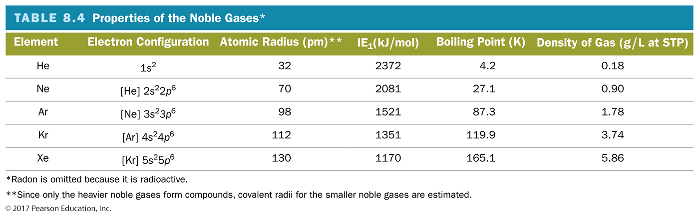
Noble Gases

